Slide 1
Changelog
2015-09-19 | Updated slide 56 with supported languages | mlabib@
2015-09-19 | Updated spelling typos on slide 90 | mlabib@
2015-09-19 | Changed “High-Level SDKs” to “Mobile SDKs” to avoid ambiguity on side 67. | mlabib@
2016-01-20 | Major revisions to get up to date with current developer services, removed the deployment content because it exists in a devops focused module now. | tffuller@
2017-02-09 | Major 20 slide revisions. Removed SWF in place of Step Functions | awwestri@

Slide 2
Developing Apps in AWS
© 2017 Amazon Web Services, Inc. and its affiliates. All rights served. May not be copied, modified, or distributed in whole or in part without the express consent of Amazon Web Services, Inc.

Slide 3
Overview
SDKs and IDE toolkits
Working with S3 and Dynamo DB
Working with SQS and SNS
Step Functions and Kinesis
Lambda and API Gateway
Building a Mobile App
Q&A
Notes:
Overview of session

Slide 4
1
SDKs and IDE toolkits

Slide 5
Low-Level AWS APIs
REST API’s for all services
Very complex to create signed URLs

Slide 6
All AWS APIs Are REST based
No one does this,
this is
extremely complex.
Create canonical request
Create a hash of request, append to the request
Create a string to sign from
Derive a signing key with recursive keyed hash operation
Create the request signature
Add signature to the header

Slide 7
Enter the SDKs
// Print the number of Amazon S3 Buckets.
IAmazonS3 s3Client = AWSClientFactory.CreateAmazonS3Client();
try
{
ListBucketsResponse response = s3Client.ListBuckets();
int numBuckets = 0;
if (response.Buckets != null && response.Buckets.Count > 0)
{
numBuckets = response.Buckets.Count;
}
sr.WriteLine("You have " + numBuckets + " Amazon S3 bucket(s).");
}
Handles all REST call details
Handles access key management (store in config files or EC2 Roles)
Exposes all services as an object oriented API

Slide 8







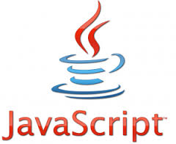


What SDKs Exist?

Slide 9
Java SDK
AWS Labs
Core
High-Level APIs
AWS Labs (Github)
Amazon Kinesis Client Library
AWS Resource APIs
DynamoDB Transaction Library
High-level APIs
Amazon DynamoDB Document API
Amazon DynamoDB Mapper
Amazon S3 Encryption Client
Amazon SQS Buffered Client
Amazon SES JavaMail Provider
Amazon S3 Transfer Manager
SDK Core
~40 Service Clients
AWS Credentials Providers
Metrics Collection Infrastructure

Slide 10

Best Practice #1 – CredentialProvider
Use ProfileCredentialsProvider for local development
Same as CLI
Use profiles to avoid leaking credentials
For production use InstanceProfileCredentialsProvider
Using IAM EC2 Roles
Use AWSCredentialsProviderChain to get automatic local > instance promotion benefit

Slide 11
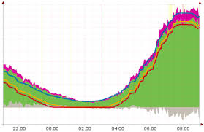
Best Practice #2 – Enable Client Side Metrics
Per-Request metrics
ClientExecuteTime, HttpRequestTime
HttpClientPoolLeasedCount, RetryCount
Per-Service metrics
S3DownloadThroughput, S3UploadThroughput
Per-JVM metrics
TotalMemory, usedMemory
ThreadCount, OpenFileDescriptorCount
Notes:
High-level description of EBS: network-based virtual disks, pay for what you provision, build-in redundancy (essentially RAID10), optimized for random I/O

Slide 12

Best Practice #3 – Client Side Encryption
AmazonS3EncryptionClient()
Uses Envelope Encryption
Unique randomly generated symmetric key
That key is then encrypted using a master key from your application
Supports AES-GCM AuthenticatedEncryption
Generates Crypto hash of the data as it is encrypted to ensure integrity
Notes:
High-level description of EBS: network-based virtual disks, pay for what you provision, build-in redundancy (essentially RAID10), optimized for random I/O

Slide 13
.NET SDK
AWS Tools for Windows PowerShell
AWS Toolkit for Visual Studio
ASP.NET Session Provider
Trace Listener
AWS SDK for .NET
“higher-level” utility apis
Amazon S3 TransferUtility
Amazon DynamoDB Object Persistence
VM Import
…
“low-level” service apis
Service Clients
.NET 3.5
.NET 4.5
Phone
Store

Slide 14
.NET SDK – Credentials Search
User Code
<appSettings> <add key=“AWSProfileName” value=“profilename” /> </appSettings>
var client = new AmazonEC2Client();
or
new AmazonEC2Client(new StoredProfileAWSCredentials(“default”));
SDK
1
Lookup “profilename” in SDK store
3
Check for instance role
2
Lookup “profilename” in credential file
EC2 Instance Metadata
SDK Store
Credentials File
Success

Slide 15
.NET SDK – Cool Features
OR Mappers to Dynamo DB
VM Import
S3Link (interops with Java SDK!)
NuGet Extensions
CognitoCredentialsProvider()

Slide 16


IDE Toolkits
Eclipse
Visual Studio
Windows Powershell

Slide 17
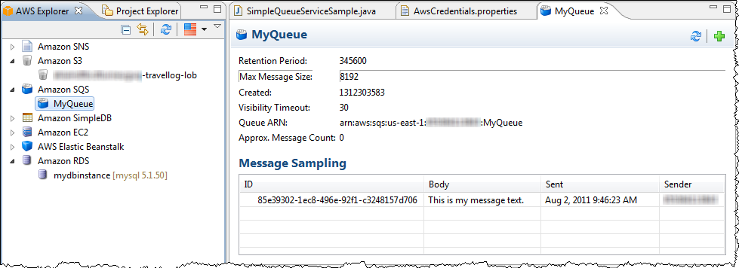
AWS Toolkit for Eclipse
AWS Explorer
AWS Elastic Beanstalk Deployment and Debugging
AWS CloudFormation Template Editor
Support for multiple AWS Accounts

Slide 18
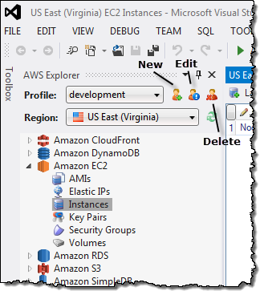
AWS Toolkit for Visual Studio
AWS Explorer
AWS Elastic Beanstalk Deployment and Debugging
AWS CloudFormation Template Editor
Support for multiple AWS Accounts
AWS Standalone Deployment Tool

Slide 19
2
S3 and DynamoDB

Slide 20
Amazon S3 (Simple Storage Service)
Web accessible object store
Objects stored are URLs
Offload web-serving work to S3 for static objects
Reduce pressure on block storage
Pay for exactly what you use
Use lifecycle rules to age things out
Highly durable (11 9’s of durability)
Limitlessly scalable
Bucket policies and ACLs
Parallel I/O for max speed (ranged GETs and multipart uploads)
Multiple options for Server and Client side encryption

Slide 21
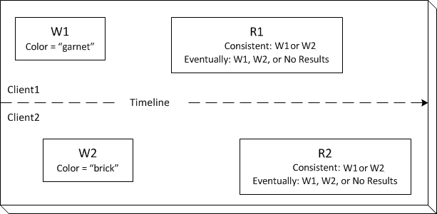
Understanding the Consistency Model
Read-After-Write Consistency for all regions when using PUT (new object)
Eventual Consistency for all regions when using overwrite PUT and DELETE
Updates to a single key are atomic
Until PUTs or DELETEs are propagated you can get dirty reads
No object locking … last in wins
Notes:
http://docs.aws.amazon.com/AmazonS3/latest/dev/s3-dg.pdf

Slide 22
Consistent Performance Tips
Regularly exceeding 100 (PUT/LIST/DELETE)/sec or 300 GET/sec
For GET intensive workloads use CloudFront
Use S3 Transfer Acceleration for long distances between you and the region
For many objects within a bucket, key naming is critical for optimal performance across partitions:
Consider a 3-4 hexadecimal prefix with MD5 hash (below)
Consider your own custom groupings
examplebucket/animations/232a-2013-26-05-15-00-00/cust1234234/animation1.obj
examplebucket/animations/7b54-2013-26-05-15-00-00/cust3857422/animation2.obj
examplebucket/animations/921c-2013-26-05-15-00-00/cust1248473/animation3.obj
examplebucket/videos/ba65-2013-26-05-15-00-00/cust8474937/video2.mpg
examplebucket/videos/8761-2013-26-05-15-00-00/cust1248473/video3.mpg
examplebucket/videos/2e4f-2013-26-05-15-00-01/cust1248473/video4.mpg
examplebucket/videos/9810-2013-26-05-15-00-01/cust1248473/video5.mpg
examplebucket/videos/7e34-2013-26-05-15-00-01/cust1248473/video6.mpg
examplebucket/videos/c34a-2013-26-05-15-00-01/cust1248473/video7.mpg
...
NOTE: If you expect to spike to 300/800 then contact support
Notes:
Read: http://docs.aws.amazon.com/AmazonS3/latest/dev/request-rate-perf-considerations.html

Slide 23
Parallelizing PUTs
static void Main(string[] args)
{
Try{
TransferUtility fileTransferUtility = new TransferUtility(
new AmazonS3Client(Amazon.RegionEndpoint.USEast1));
// 1. Upload a file, file name is used as the object key name.
fileTransferUtility.Upload(filePath, existingBucketName);
Console.WriteLine("Upload 1 completed");
// 2. Specify object key name explicitly.
fileTransferUtility.Upload(filePath,existingBucketName, keyName);
Console.WriteLine("Upload 2 completed");
// 3. Upload data from a type of System.IO.Stream.
using (FileStream fileToUpload =
new FileStream(filePath, FileMode.Open, FileAccess.Read)){
fileTransferUtility.Upload(fileToUpload,existingBucketName, keyName);
}
Console.WriteLine("Upload 3 completed");
// 4.Specify advanced settings/options.
TransferUtilityUploadRequest fileTransferUtilityRequest =
new TransferUtilityUploadRequest{
BucketName = existingBucketName,
FilePath = filePath,
StorageClass = S3StorageClass.ReducedRedundancy,
PartSize = 6291456, // 6 MB.
Key = keyName,
CannedACL = S3CannedACL.PublicRead
};
fileTransferUtilityRequest.Metadata.Add("param1", "Value1");
fileTransferUtilityRequest.Metadata.Add("param2", "Value2");
fileTransferUtility.Upload(fileTransferUtilityRequest);
Console.WriteLine("Upload 4 completed");
}
catch (AmazonS3Exception s3Exception){
Console.WriteLine(s3Exception.Message,
s3Exception.InnerException);
}
}
Increase aggregate throughput with multipart uploads
Increases resiliency because you are no longer “all or nothing”
Single PUT can only do 5 GB
Multi-Part PUT can get up to 5 TB of full object size
Allows for pause/resume
Pick the right part size
High bandwidth = 25 MB – 50 MB
Low bandwidth = 10 MB
Use AES-256 to optimize security and performance
Notes:
Read: http://docs.aws.amazon.com/AmazonS3/latest/dev/request-rate-perf-considerations.html

Slide 24
Parallelizing GETs
Use range-based GETs to multithread
Compensates for unreliable networks
Align your ranges with your parts!
Use parallel LIST when you need a sequential list of your keys
Use secondary indexes
You have to build and maintain it yourself
AmazonS3 s3Client = new AmazonS3Client(new ProfileCredentialsProvider());
GetObjectRequest rangeObjectRequest = new GetObjectRequest(bucketName, key);
rangeObjectRequest.setRange(0, 10); // retrieve 1st 10 bytes.
S3Object objectPortion = s3Client.getObject(rangeObjectRequest);
InputStream objectData = objectPortion.getObjectContent();
// Process the objectData stream.
objectData.close();
Notes:
Read: http://docs.aws.amazon.com/AmazonS3/latest/dev/request-rate-perf-considerations.html

Slide 25
Creating Signed URLs
As-needed short-term access to S3 resources
To share objects without distributing keys you can use the SDK
Parameters:
Security credentials
Bucket name
Object key
HTTP Method
Expiration date/time
(OPTIONAL) Custom Policy (IP Address, Access Start Date)
public class GeneratePreSignedUrl {
private static String bucketName = "*** Provide a bucket name ***";
private static String objectKey = "*** Provide an object key ***";
public static void main(String[] args) throws IOException {
AmazonS3 s3client = new AmazonS3Client(new ProfileCredentialsProvider());
try {
System.out.println("Generating pre-signed URL.");
java.util.Date expiration = new java.util.Date();
long milliSeconds = expiration.getTime();
milliSeconds += 1000 * 60 * 60; // Add 1 hour.
expiration.setTime(milliSeconds);
GeneratePresignedUrlRequest generatePresignedUrlRequest =
new GeneratePresignedUrlRequest(bucketName, objectKey);
generatePresignedUrlRequest.setMethod(HttpMethod.GET);
generatePresignedUrlRequest.setExpiration(expiration);
URL url = s3client.generatePresignedUrl(generatePresignedUrlRequest);
System.out.println("Pre-Signed URL = " + url.toString());
} catch (AmazonServiceException exception) {
System.out.println("Caught an AmazonServiceException”)
}
catch (AmazonClientException ace) {
System.out.println("Error Message: " + ace.getMessage());
}
}
}
Notes:
Custom Policy - http://docs.aws.amazon.com/AmazonCloudFront/latest/DeveloperGuide/private-content-creating-signed-url-custom-policy.html

Slide 26
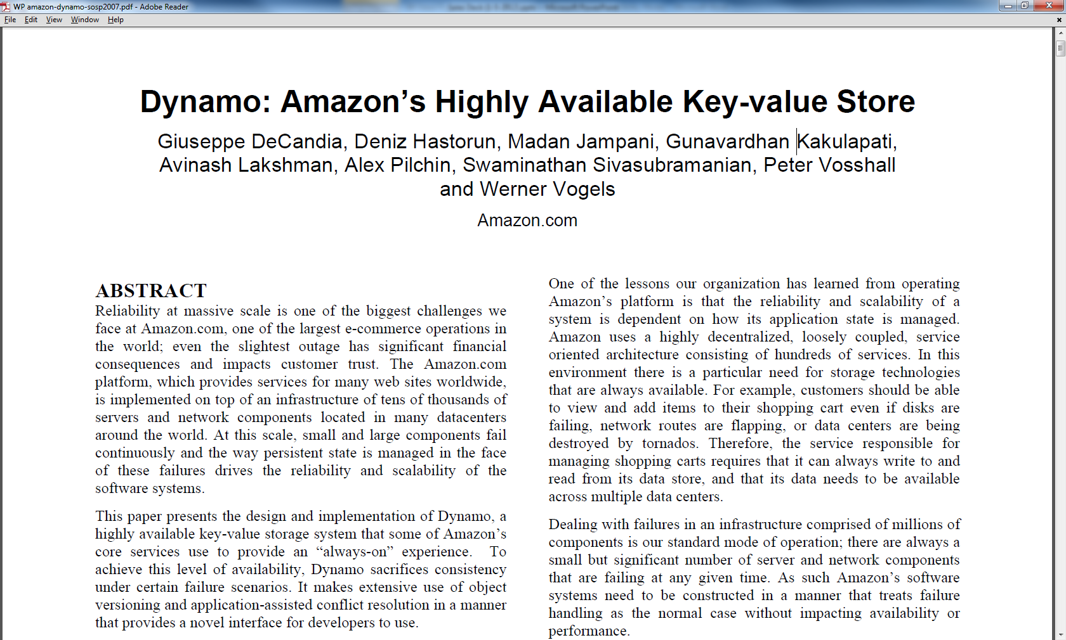
Amazon.com: Distributed
Dynamo = NoSQL Technology
Consistent hashing
Optimistic replication
“Sloppy quorum”
Anti-entropy mechanisms
Object versioning

Slide 27
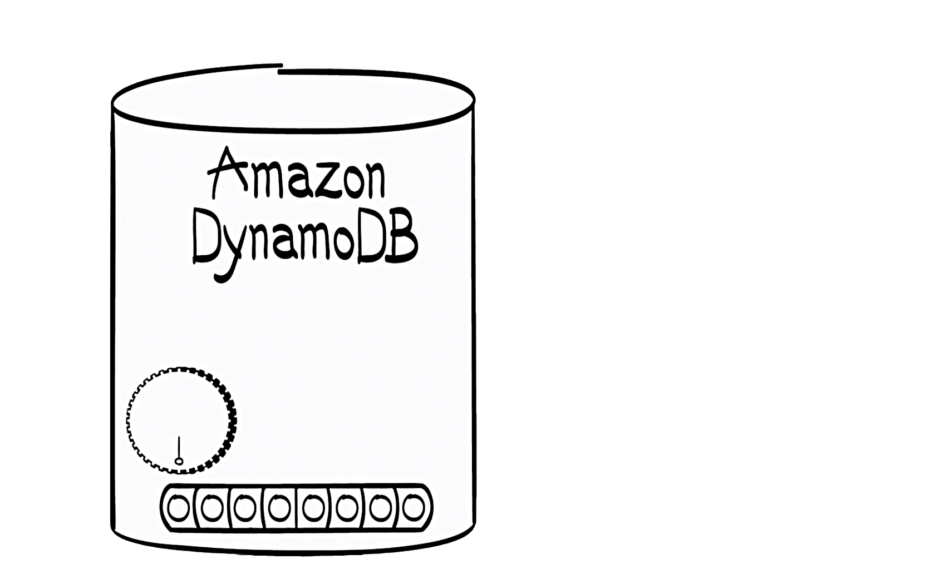
Amazon.com: Cloud
Dynamo DB = NoSQL Cloud Service
Non-Relational
Fast & Predictable Performance
Seamless Scalability
Easy Administration
Fast development
Always durable
Pay for what you need when you need it
designed for
Tier One
applications

Slide 28
Massive and Seamless Scale
DynamoDB automatically partitions data by the hash key
Hash key spreads data (& workload) across partitions
Auto-partitioning occurs with:
Data set size growth
Provisioned capacity increases
Ideal apps should have
Large number of unique hash keys
Uniform distribution of workload across hash keys
table
partitions
1 .. N

Slide 29
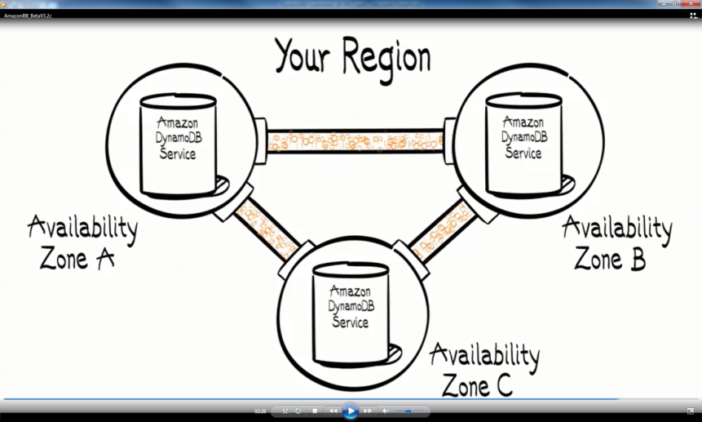
Making life easier for developers
RESTful interface
Performance index tuning (reduce latency)
Durability - Automatic 3-way multi-AZ replication
Scalability (and scaling operations)
Security inspections, patches, upgrades
Software upgrades, patches
Automatic hardware failover
Improving the underlying hardware
WRITES
Continuously replicated to 3 AZ’s
Quorum acknowledgment
Persisted to disk (custom SSD)
READS
Strongly or eventually consistent
No trade-off in latency

Slide 30
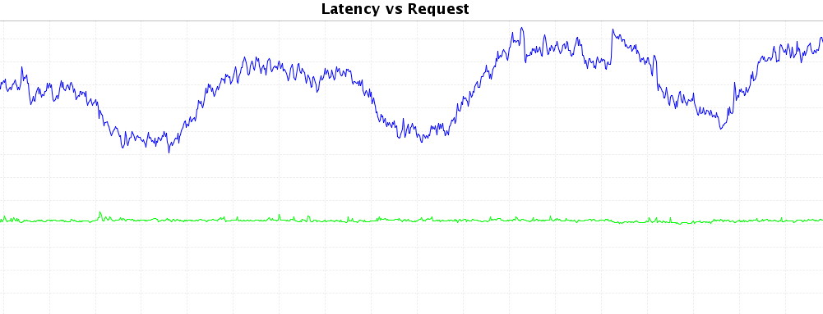
Predictable Performance
Provisioned Throughput
Request-based capacity provisioning model
Throughput is declared and updated via the API or the console
CreateTable([TableName], reads/sec = 100, writes/sec = 150)
UpdateTable([TableName], reads/sec = 10,000, writes/sec = 4500)
DynamoDB handles the rest
Capacity is reserved and available when needed
Scaling-up triggers repartitioning and reallocation
No impact to performance or availability

Slide 31
Highlighted Features
Consistent reads
Inventory, shopping cart applications
Atomic Counters
Increment and return new value in same operation
Conditional Writes
Expected value before write – fails on mismatch
Sparse Indexes
Ideal for sorted lists; fast access to a subset of items (leaderboards, top lists)
Cross-Region export/import
Secondary Indexes (local and global)
DynamoDB Local
Fine-Grained Access Control
Geospatial and Transaction Libraries
JSON support
private static void updateExistingAttributeConditionally() {
Table table = dynamoDB.getTable(tableName);
try {
Map<String, String> expressionAttributeNames = new HashMap<String, String>();
expressionAttributeNames.put("#p", "Price");
// Specify the desired price (25.00) and also the condition (price =
// 20.00)
Map<String, Object> expressionAttributeValues = new HashMap<String, Object>();
expressionAttributeValues.put(":val1", 25);
expressionAttributeValues.put(":val2", 20);
UpdateItemSpec updateItemSpec = new UpdateItemSpec()
.withPrimaryKey("Id", 120)
.withReturnValues(ReturnValue.ALL_NEW)
.withUpdateExpression("set #p = :val1")
.withConditionExpression("#p = :val2")
.withNameMap(expressionAttributeNames)
.withValueMap(expressionAttributeValues);
UpdateItemOutcome outcome = table.updateItem(updateItemSpec);
// Check the response.
System.out
.println("Printing item after conditional update to new attribute...");
System.out.println(outcome.getItem().toJSONPretty());
} catch (Exception e) {
System.err.println("Error updating item in " + tableName);
System.err.println(e.getMessage());
}
}

Slide 32
Best Practices
Table
Design for uniform data access across items in your tables
Understand partition behavior
Use burst capacity sparingly
Distribute Write activity during data upload
Understand access patterns for time series data
Cache popular items
Consider workload uniformity when adjusting Provisioned throughput
Test your application at scale
Item
Use 1:many Tables instead of large set attributes
Use multiple tables to support varied access patterns
Compress large attribute values
Store large attribute values in S3
Break up large attributes across multiple items
Query and Scan
Avoid sudden bursts of read activity
Create exponential-backoff retry logic upon limit failures
Take advantage of parallel scans
Local Secondary Index
Use indexes sparingly
Choose Projections carefully
Optimize queries to avoid fetches
Take advantage of sparse indexes
Watch for Expanding Item collections
Global Secondary Index
Choose a key that will provide uniform workloads
Take advantage of sparse indexes
Use a global secondary index for quick lookups
Create an eventually consistent read replica
Notes:
http://docs.aws.amazon.com/amazondynamodb/latest/developerguide/BestPractices.html

Slide 33
3
SQS and SNS

Slide 34

Amazon SQS (Simple Queue Service)
Web accessible read/write queue
Redundant infrastructure
Multiple readers and writers
Configurable settings per queue
Variable message size
Access Control options
Delay queues (up to 15 min invisible time)
Dead Letter Queues
Un-ordered or FIFO ordering
Notes:
Message Order (best effort)
At-Least-Once delivery
14 day max retention
256 KB message size (in 64 KB pieces)
Access can be restricted by IP Address and time of day

Slide 35
Message Polling & Sampling
Short polling
ReceiveMessages call uses WaitTimeSeconds parameter set to 0
SQS samples a subset of the servers based on weighted random distribution
With less than 1000 messages you could return no messages
Long polling
Allows SQS to wait (up to 20 seconds) for a message to arrive before responding
Reduces the number of empty responses
SQS samples all servers
Client Application
Client Application
Message Queue (SQS)
Message Consumer
Client Application

Slide 36
Processing & Batching
Processing features
Visibility timeout
Shared Queues w/ Access Policies
Batch APIs
Messages can be sent, received, or deleted 10 at a time
ReceiveMessage, SendMessageBatch, DeleteMessageBatch, ChangeMessageVisibilityBatch API
Individual messages in the batch can fail, always check for errors
SendMessageBatchResult batchResult = sqsClient.sendMessageBatch(batchRequest);
if (!batchResult.getFailed().isEmpty()) {
log.warn("Producer: retrying sending " + batchResult.getFailed().size() + ”messages");
for (int i = 0, n = batchResult.getFailed().size(); i < n; i++){
sqsClient.sendMessage(new SendMessageRequest(queueUrl, theMessage));
}
}

Slide 37


Amazon SNS (Simple Notification Service)
Single published message
Subscribers Include
SQS, Lambda, other applications
HTTP(S)
Email
SMS
Mobile Push
Order not guaranteed
No Recall
HTTP(S) retry
Linear
Geometric
Exponential backoff
256 KB per message (non-SMS)
Lambda
SQS
HTTP/S
Publisher
Email
SNS Topic
SMS
Mobile Push
Other Apps

Slide 38
4
Kinesis and Step Functions

Slide 39
Amazon Kinesis

Slide 40
Foundation For Stream Data Ingestion, Continuous Processing
Real-time Ingest
Continuous Processing FX
Highly Scalable
Durable
Elastic
Replay-able Reads
Elastic
Load-balancing incoming streams
Fault-tolerance, Checkpoint / Replay
Enable multiple processing apps in parallel
Managed Service
Low end-to-end latency
Enable data movement into Stores/ Processing Engines

Slide 41
Amazon Kinesis: Streaming Data Ingestion

Slide 42
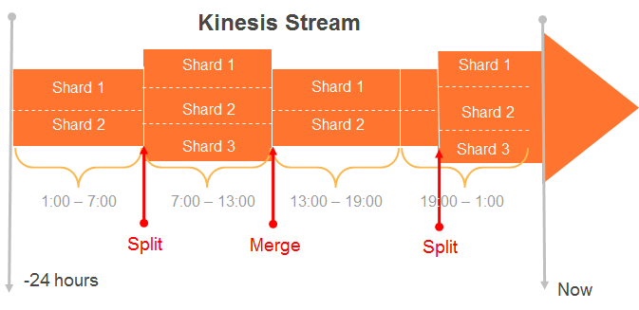
Kinesis Stream
Streams are made of Shards
Each Shard ingests data up to 1MB/sec, and up to 1000 TPS
Each Shard emits up to 2 MB/sec
All data is stored for 24 hours (extended storage up to 7 days)
Scale Kinesis streams by splitting or merging Shards
Replay data inside of 24Hr. Window

Slide 43
Putting Data into Kinesis
Producers use a PUT call to store data in a Stream. Each record <= 50KB.
PutRecord {Data, StreamName, PartitionKey}
A Partition Key is supplied by producer and used to distribute the PUTs across Shards
Kinesis MD5 hashes supplied partition key over the hash key range of a Shard
A unique Sequence # is returned to the Producer upon a successful PUT call

Slide 44
Putting Data into Kinesis: Code Sample
// Write records to the stream until this program is aborted.
while (true) {
long createTime = System.currentTimeMillis();
PutRecordRequest putRecordRequest = new PutRecordRequest();
putRecordRequest.setStreamName(myStreamName);
putRecordRequest.setData(ByteBuffer.wrap(String.format("testData-%d", createTime).getBytes()));
putRecordRequest.setPartitionKey(String.format("partitionKey-%d", createTime));
PutRecordResult putRecordResult = kinesis.putRecord(putRecordRequest);
System.out.printf("Successfully put record, partition key : %s, ShardID : %s, SequenceNumber : %s.\n",
putRecordRequest.getPartitionKey(),
putRecordResult.getShardId(),
putRecordResult.getSequenceNumber());
}

Slide 45
Best Practices: Determine Your Partition Key Strategy
Kinesis as a managed buffer or a streaming map-reduce
Ensure a high cardinality for Partition Keys with respect to shards, to prevent a “hot shard” problem
Generate Random Partition Keys
Streaming Map-Reduce: Leverage Partition Keys for business specific logic as applicable
Partition Key per billing customer, per DeviceId, per stock symbol

Slide 46
Best Practices: Provisioning Adequate Shards
For ingress needs
Egress needs for all consuming applications: If more than 2 simultaneous consumers
Include head-room for catching up with data in stream in the event of application failures

Slide 47
Best Practices: Putting Data in Kinesis Pre-Batch before Puts for better efficiency
Consider FluentD, Flume as collectors/ agents
Generates random partition keys
Set number of threads to buffer
https://github.com/awslabs/aws-fluent-plugin-kinesis
Consider Async producer – present in AWS SDK
Default ThreadPoolExecutor runs 50 threads to execute requests
If not enough: use SynchronousQueue or ArrayBlockingQueue
Notes:
The AWS SDK for Java defaults to queuing in the case of (3). The default ThreadPoolExecutor used by the AWS SDK for Java’s async clients runs 50 threads to execute requests; if a new request arrives when all 50 threads are busy, it gets put into a queue until a thread becomes available to process it. This smooths over temporary spikes in requests without failures, however if your request rate consistently exceeds your maximum throughput the queue will grow larger and larger until your process OOMs.
If you would prefer fail-fast behavior, that’s pretty easy to configure:
BlockingQueue<Runnable> queue = new SynchronousQueue<Runnable>();
ExecutorService executor = new ThreadPoolExecutor(…, queue);
return new AmazonDynamoDBClient(credentials, executor);
A SynchronousQueue will not allow new requests to be submitted unless there’s an idle thread waiting to immediately start processing the request; calling an xxxAsync method on the client when all threads are already busy will immediately throw a RejectedExecutionException.
A hybrid approach would be to use a bounded-size queue, such as an ArrayBlockingQueue. If all threads are busy, requests will initially be put into the queue and processed later. However, once the queue reaches its maximum configured size, new requests will be rejected. This can smooth over small bursts of requests, but still prevents a large burst from bringing down the entire process with an OOM. The trick is picking an appropriate maximum size for the queue.

Slide 48

Best Practices: Pre-Batch before Puts for better efficiency
# KINESIS appender
log4j.logger.KinesisLogger=INFO, KINESIS
log4j.additivity.KinesisLogger=false
log4j.appender.KINESIS=com.amazonaws.services.kinesis.log4j.KinesisAppender
# DO NOT use a trailing %n unless you want a newline to be transmitted to KINESIS after every message
log4j.appender.KINESIS.layout=org.apache.log4j.PatternLayout
log4j.appender.KINESIS.layout.ConversionPattern=%m
# mandatory properties for KINESIS appender
log4j.appender.KINESIS.streamName=testStream
#optional, defaults to UTF-8
log4j.appender.KINESIS.encoding=UTF-8
#optional, defaults to 3
log4j.appender.KINESIS.maxRetries=3
#optional, defaults to 2000
log4j.appender.KINESIS.bufferSize=1000
#optional, defaults to 20
log4j.appender.KINESIS.threadCount=20
#optional, defaults to 30 seconds
log4j.appender.KINESIS.shutdownTimeout=30
Make a tweak to your existing logging
log4j appender option
https://github.com/awslabs/kinesis-log4j-appender

Slide 49
Best Practice: ProvisionedThroughputExceeded
Retry if rise in input rate is temporary
Reshard to increase number of shards
Monitor CloudWatch metrics: PutRecord.Bytes and GetRecords.Bytes metrics keep track of shard usage
Keep track of your metrics
Log hashkey values generated by your partition keys
Log Shard-Ids
Determine which Shard receive the most (hashkey) traffic.
Metric | Units
PutRecord.Bytes | Bytes
PutRecord.Latency | Milliseconds
PutRecord.Success | Count
putRecordRequest.setPartitionKey
(String.format( "myPartitionKey"));
String shardId = putRecordResult.getShardId();
Notes:
PutRecord.Bytes The number of bytes put to the Amazon Kinesis stream over the specified time period.
PutRecord.Latency The time taken per PutRecord operation, measured over the specified time period.
PutRecord.Success The number of successful PutRecord operations per Amazon Kinesis stream, measured over the specified time period.
GetRecords.Bytes The number of bytes retrieved from the stream, measured over the specified time period.
GetRecords.IteratorAgeMilliseconds The age of the iterator used to request records for all shards in your stream, measured over the specified time period.
GetRecords.Latency The time taken per GetRecords operation, measured over the specified time period.
GetRecords.Success The number of successful GetRecords operations per stream, measured over the specified time period.

Slide 50
Best Practices: Scaling Kinesis Shards
Options:
stream-name - The name of the Stream to be scaled
scaling-action - The action to be taken to scale. Must be one of "scaleUp”, "scaleDown" or “resize"
count - Number of shards by which to absolutely scale up or down, or resize to or:
pct - Percentage of the existing number of shards by which to scale up or down
java -cp KinesisScalingUtils.jar-complete.jar -Dstream-name=MyStream -Dscaling-action=scaleUp -Dcount=10 -Dregion=eu-west-1
https://github.com/awslabs/amazon-kinesis-scaling-utils
Notes:
The Kinesis Scaling Utility is designed to give you the ability to scale Amazon Kinesis Streams in the same way that you scale EC2 Auto Scaling groups – up or down by a count or as a percentage of the total fleet. You can also simply scale to an exact number of Shards. There is no requirement for you to manage the allocation of the keyspace to Shards when using this API, as it is done automatically.
The utility might be used as part of a larger scaling environment, where you use the library directly from your application via the StreamScaler class. This allows you to call scaleUp or scaleDown with an increment or a percentage, or to set the exact number of shards required. Alternatively you might use the ScalingClient command line utility, which allows you to run the utility from any host environment with switches like “-Daction=scaleUp –Dcount=10"

Slide 51








Sending & Reading Data from Kinesis Streams
Sending
Consuming
HTTP Post
Get* APIs
AWS SDK
Kinesis Client Library
+
Connector Library
AWS Mobile SDK
Apache Storm
LOG4J
Flume
Amazon Elastic MapReduce
Fluentd
Notes:
Lots of way to process streaming data, just like there are lots of ways to process batch data with Hadoop
Open source from AWS

Slide 52
Amazon Kinesis: Build Apps w/ Kinesis Client Library

Slide 53

Building Kinesis Applications: Open Source library for fault-tolerant, continuous processing apps
Java client library, also available for Python Developers
Source available on Github
Build app with Kinesis Client Library
Deploy on your set of EC2 instances
Every KCL application includes these components:
Record processor factory: Creates the record processor
Record processor: The processing unit that processes data from a shard of a Kinesis stream
Worker: The processing unit that maps to each application instance
Notes:
Kinesis Client library simplifies parallel processing of streaming big data by allowing customers to write simple applications for processing records. Kinesis is a Java library that customers compile into their data processing application. The application with the Kinesis library is called a Kinesis Worker. Kinesis’s library notifies the customer’s processing code when there is new data to process. Kinesis Workers will often process data and write output to an external data store such as DynamoDB, EMR, Redshift, or S3. Kinesis guarantees that every record within a Kinesis Data stream is processed at least once

Slide 54
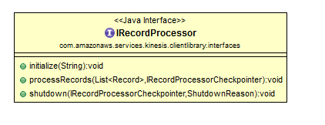
IRecordProcessor: The Heart of Kinesis Client Library
The KCL uses the IRecordProcessor interface to communicate with your application
A Kinesis application must implement the KCL's IRecordProcessor interface
Contains the business logic for processing the data retrieved from the Kinesis stream
Notes:
Questions
I am using the Kinesis Client Library to process records from multiple producers. I am trying to implement some basic duplication checking and was wondering what the behavior of sequence numbers is in regard to a single IRecordProcessor instance.
Are sequence numbers guaranteed to be monotically increasing?
[GG] Yes – Kinesis guarantees that records are returned in order for a shard. KCL will pass the records in order to the instance of the IRecordProcessor.
Are the records in the List<> passed to processRecords sorted by their sequence number?
[GG] Yes – same reason/motivation as above.
Would a given sequence number ever be delivered to more than one instance of the IRecordProcessor interface at the same time?
[GG] Yes – KCL guarantees at least once semantics. There are edge cases around fail over and load balancing where, for a brief period, records from a shard can be worked on by multiple record processor instances.

Slide 55
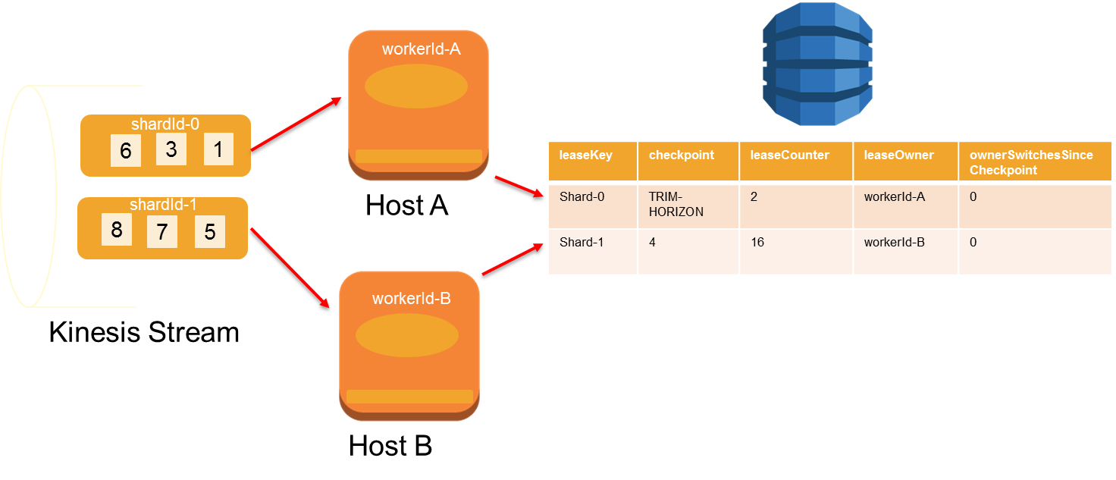
State Management with Kinesis Client Library
One record processor maps to one shard and processes data records from that shard
One worker maps to one or more record processors
Balances shard-worker associations when worker / instance counts change
Balances shard-worker associations when shards split or merge
Notes:
The KCL automatically creates a DynamoDB table for each Kinesis application to keep track and maintain state information.
The KCL uses the name of the Amazon Kinesis application as the name of the DynamoDB table. Each application name must be unique within a region.
Your account is charged for this DynamoDB usage.
Each row in the DynamoDB table represents a shard in the Kinesis stream.
Application State Data:
Shard ID: Hash key for the shard that is being processed by your application.
Checkpoint: The most recent checkpoint sequence number for the shard.
Worker ID: The ID of the worker that is processing the shard.
Lease/Heartbeat: A count that is periodically incremented by the record processor.
The read/write throughput for the DynamoDB table depends on the number of shards and how often your application
Once a shard is completely processed, the record processor that was processing it should receive a call to its shutdown
method with the reason "TERMINATE", client's should call checkpointer.checkpoint() when the shutdown reason is
"TERMINATE" so that the end of the shard is checkpointed. If cleanupLeasesUponShardCompletion is set to true in
your KinesisClientLibConfiguration this will allow the shard sync task to clean up the lease for that shard.
You can check your lease table in dynamodb, it will be named the same as the application name provided to your
Workers. In that table you can confirm whether or not the leases for the closed shards have been checkpointed at
SHARD_END or not.

Slide 56
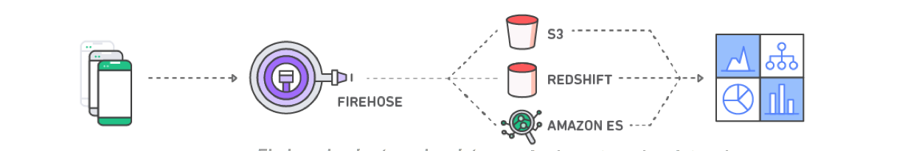
Amazon Kinesis Firehose Load massive volumes of streaming data into Amazon S3, Redshift and Elasticsearch
Capture and submit streaming data
Firehose loads streaming data continuously into Amazon S3, Redshift and Elasticsearch
Analyze streaming data using your favorite BI tools
Zero administration: Capture and deliver streaming data into Amazon S3, Amazon Redshift, and other destinations without writing an application or managing infrastructure.
Direct-to-data store integration: Batch, compress, and encrypt streaming data for delivery into data destinations in as little as 60 secs using simple configurations.
Seamless elasticity: Seamlessly scales to match data throughput w/o intervention
Serverless ETL using AWS Lambda - Firehose can invoke your Lambda function to transform incoming source data.
Notes:
https://aws.amazon.com/about-aws/whats-new/2016/12/amazon-kinesis-firehose-can-now-prepare-and-transform-streaming-data-before-loading-it-to-data-stores/

Slide 57

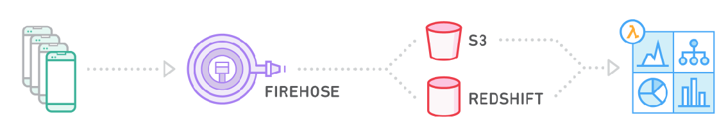
Amazon Kinesis Firehose Load massive volumes of streaming data into Amazon S3 and Amazon Redshift
Capture and submit streaming data to Firehose
Firehose loads streaming data continuously into S3 and Redshift
Analyze streaming data using your favorite BI tools
Zero administration: Capture and deliver streaming data into S3, Redshift, and other destinations without writing an application or managing infrastructure.
Direct-to-data store integration: Batch, compress, and encrypt streaming data for delivery into data destinations in as little as 60 secs using simple configurations.
Seamless elasticity: Seamlessly scales to match data throughput w/o intervention

Slide 58
When to Use Kinesis Streams vs Firehose
 | Kinesis Streams | Kinesis Firehose
Granularity | Processed individually | Micro-batched
Ease-of-use | High | Low
Delivery Scaling | Manual | Automatic
Output Sources | Flexible (via Client Library) | S3, ElasticSearch, RedShift
Performance | ms | Buffer interval

Slide 59
Step Functions
…makes it easy to coordinate the components of distributed applications using visual workflows.
File Type Conversion
Parallel Image Processing

Slide 60
Define in JSON and Then Visualize in the Console
{
”Comment”: “Hello World Example",
"StartAt” : "HelloWorld”,
"States” : {
"HelloWorld” : {
"Type” : "Task",
"Resource” : "arn:aws:lambda:REGION:ACCOUNT_ID:function:FUNCTION_NAME”,
"End” : true
}
}
}
Start
HelloWorld
End

Slide 61
Step Functions Implementation
Task | A single unit of work
Choice | Adds branching logic
Parallel | Fork and join the data across tasks
Wait | Delay for a specified time
Fail | Stops an execution and marks it as a failure
Succeed | Stops an execution successfully
Pass | Passes its input to its output
7 State Types
Monitor executions and history from Console, Cloudwatch or API
Tasks Executed by:
Push Model – Lambda
Poll Model – EC2, Container, OnPremise
Pay by State Transition

Slide 62
What is SWF?
Enables scalable, resilient, truly distributed applications
Makes it easy to build applications that coordinate work across distributed components.
Durable, distributed state management
Asynchronous invocation and even-driven execution
Accessible anywhere from any programming language
Low cost, reliability, and scalability are all built in
Notes:
Orchestration tool across your infrastructure.
Allows for loosely couple designs
Use it as a middle layer to pass messages and set up tasks to be completed.
Break down individual tasks into different workers.
You define logic between workers.
Anything that can be scripted, can be made into a workflow task.
Built-in retries, timeouts, and logging.
Low cost, reliability, and scalability are all built in

Slide 63
Why SWF?
Building reliable task dispatch & state management is hard
Provides asynchronous interactions and loosely couple designs
Lack of task based programming models
Developers should concentrate on building business functionality
Reduce infrastructure and administration costs
No longer need to run, and operate the orchestration infrastructure
Notes:
Emerging Needs like:
Asynchronous interactions and loosely couple designs
Applications that run across datacenters and cloud providers
Efficient resource usage, scalability
Reliable task dispatch & state management are difficult to implement
Lack of task based programming models
Developers should concentrate on building business functionality and not on building the plumbing for orchestration

Slide 64
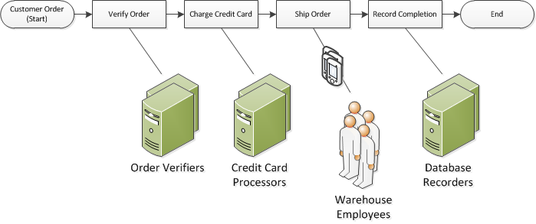
Sample E-Commerce Application

Slide 65
Simple Workflow Concepts
The fundamental concept in Amazon SWF is the workflow
A workflow contains
A set of activities that carry out some objective
and logic that coordinates these activities
Workflows activities
Can be run asynchronously across multiple computing devices
Can feature both sequential and parallel processing
The order in which activities are performed is determined by the workflow's coordination logic.
Notes:
Activity tasks—and the activity workers that perform them—can run synchronously or asynchronously.
They can be distributed across multiple computers, potentially in different geographic regions, or they can all run on the same computer.
Different activity workers can be written in different programming languages and run on different operating systems.
The decider schedules activity tasks, provides input data to the activity workers, processes events that arrive while the workflow is in progress, and ultimately ends (or closes) the workflow when the objective has been completed.
An AWS account can have multiple domains, each of which can contain multiple workflows, but workflows in different domains cannot interact.

Slide 66
Simple Workflow Concepts (Continued)
A workflow execution is an running instance of a workflow
Can be started by any process or application
Even another workflow execution
Amazon SWF associates a unique system-generated identifier - a runId - with each workflow execution.
You can associate an identifier called a workflowId with your workflow executions, so you can integrate your existing business identifiers into your workflow.
Progress is recorded in the workflow history
Notes:
Activity tasks—and the activity workers that perform them—can run synchronously or asynchronously.
They can be distributed across multiple computers, potentially in different geographic regions, or they can all run on the same computer.
Different activity workers can be written in different programming languages and run on different operating systems.
The decider schedules activity tasks, provides input data to the activity workers, processes events that arrive while the workflow is in progress, and ultimately ends (or closes) the workflow when the objective has been completed.
An AWS account can have multiple domains, each of which can contain multiple workflows, but workflows in different domains cannot interact.

Slide 67
Simple Workflow Concepts (Continued)
A workflow history
A detail, complete and consistent record of every event that occurred since the workflow started
Enables applications to be stateless (all information is stored in the workflow history)
Provides a record of which activities were schedule, their status, and results
Provides detail audit trail
An activity is some logic that needs to be carried out
Can be executed multiple times
An activity task that represents one invocation of an activity
Notes:
Activity tasks—and the activity workers that perform them—can run synchronously or asynchronously.
They can be distributed across multiple computers, potentially in different geographic regions, or they can all run on the same computer.
Different activity workers can be written in different programming languages and run on different operating systems.
The decider schedules activity tasks, provides input data to the activity workers, processes events that arrive while the workflow is in progress, and ultimately ends (or closes) the workflow when the objective has been completed.
An AWS account can have multiple domains, each of which can contain multiple workflows, but workflows in different domains cannot interact.

Slide 68
Simple Workflow Concepts (Continued)
An activity worker
A process or thread that performs the activity tasks that are part of the workflow
Receives activity tasks, performs them, and provides results back
Each activity worker polls Amazon SWF for new tasks that are appropriate for that activity worker to perform
Certain tasks can be performed only by certain activity workers
Notes:
The role of the Amazon SWF service is to function as a reliable central hub through which data is exchanged between the decider, the activity workers, and other relevant entities such as the person administering the workflow.
The decider directs the workflow by receiving decision tasks from Amazon SWF and responding back to Amazon SWF with decisions. A decision represents an action or set of actions which are the next steps in the workflow.
Amazon SWF informs the decider of the state of the workflow by including with each decision task, a copy of the current workflow execution history.

Slide 69
Simple Workflow Concepts (Continued)
A decider
Contains the coordination logic in a workflow based on received decision tasks and responding with decision tasks
A decision represents an action or set of actions which are the next steps in the workflow
Schedules activity tasks, provides input data to the activity workers, processes events that arrive while the workflow is in progress, and ultimately ends (or closes) the workflow when the objective has been completed.
A decider represents a single computer process or thread
Multiple deciders can process tasks for the same workflow type
Notes:
The role of the Amazon SWF service is to function as a reliable central hub through which data is exchanged between the decider, the activity workers, and other relevant entities such as the person administering the workflow.
The decider directs the workflow by receiving decision tasks from Amazon SWF and responding back to Amazon SWF with decisions. A decision represents an action or set of actions which are the next steps in the workflow.
Amazon SWF informs the decider of the state of the workflow by including with each decision task, a copy of the current workflow execution history.

Slide 70
Simple Workflow Concepts (Continued)
Deciders and activity workers communicate with Amazon SWF using long polling.
The decider or activity worker periodically initiates communication with Amazon SWF, notifying Amazon SWF of its availability to accept a task, and then specifies a task list to get tasks from
Amazon SWF holds the TCP connection open for up to 60 seconds so that, if a task becomes available during that time, it can be returned in the same connection.
Notes:
The role of the Amazon SWF service is to function as a reliable central hub through which data is exchanged between the decider, the activity workers, and other relevant entities such as the person administering the workflow.
The decider directs the workflow by receiving decision tasks from Amazon SWF and responding back to Amazon SWF with decisions. A decision represents an action or set of actions which are the next steps in the workflow.
Amazon SWF informs the decider of the state of the workflow by including with each decision task, a copy of the current workflow execution history.
Amazon SWF holds the TCP connection open for up to 60 seconds so that, if a task becomes available during that time, it can be returned in the same connection.

Slide 71
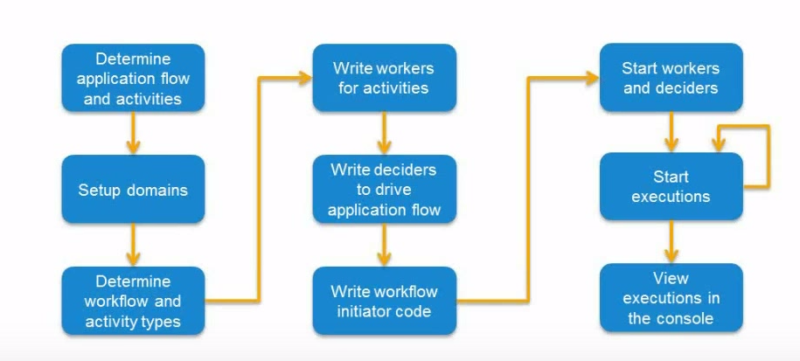
Steps to Develop and Build a Workflow
Notes:
These actors can run on any computing device that can access an Amazon SWF endpoint. For example, you could use compute instances in the cloud, such as Amazon Elastic Compute Cloud (Amazon EC2); servers in your data center; or even a mobile device, to host a decider or activity worker. Once started, the decider and activity workers should start polling Amazon SWF for tasks.

Slide 72
SWF Workflow Registration and Execution
Workflows and activity types must get registered with Amazon SWF
For each type you would specify:
a name
a version
and additional default configurations specific to each type

Slide 73
SWF Workflow Actors, Tasks, Task Lists
Actors can be workflow starters, deciders, or activity workers
A workflow starter is any application that can initiate workflow executions.
Deciders control the flow of activity tasks in a workflow execution

Slide 74
Amazon SWF Tasks
Amazon SWF interacts with activity workers and deciders by providing them with tasks (i.e. work assignments)
Activity task - An Activity task tells an activity worker to perform its function, such as to check inventory or charge a credit card
Contains all of the information needed by the worker
Could be implemented as a Lambda function
Decision task - A Decision task tells a decider that the state of the workflow execution has changed
Can determine the next activity
Contains the current workflow history.
Notes:
Amazon SWF schedules a decision task when the workflow starts and whenever the state of the workflow changes, such as when an activity task completes
An Activity task tells an activity worker to perform its function, such as to check inventory or charge a credit card.
There are a number of benefits of using Lambda tasks in place of a traditional Amazon SWF activity:
Lambda tasks don’t need to be registered or versioned like Amazon SWF activity types.
You can use any existing Lambda functions that you’ve already defined in your workflows.
Lambda functions are called directly by Amazon SWF; there is no need for you to implement a worker program to execute them as you must do with traditional activities.
Lambda provides you with metrics and logs for tracking and analyzing your function executions.
There are also a number of limitations regarding Lambda tasks that you should be aware of:
Lambda tasks can only be run in AWS regions that provide support for Lambda.
Lambda tasks are currently supported only by the base SWF HTTP API and in the AWS Flow Framework for Java.

Slide 75
Amazon SWF Tasks (Continue)
Amazon SWF assigns each decision task to exactly one decider and allows only one decision task at a time to be active in a workflow execution
When the activity task completes
Activity worker reports to Amazon SWF that the task was completed
Includes any relevant results that were generated
Amazon SWF
Updates the workflow execution history with an event that indicates the task completed
Schedules a decision task to transmit the updated history to the decider
Notes:
When an activity worker has completed the activity task, it reports to Amazon SWF that the task was completed, and it includes any relevant results that were generated. Amazon SWF updates the workflow execution history with an event that indicates the task completed and then schedules a decision task to transmit the updated history to the decider.

Slide 76
SWF Task List
There are separate lists for activity tasks and decision tasks.
Decision Task Lists
Activity Task Lists
A task is always scheduled on only one task list; tasks are not shared across lists
Notes:
Decision Task Lists
Activity Task Lists
Task Routing
There are separate lists for activity tasks and decision tasks. A task is always scheduled on only one task list; tasks are not shared across lists

Slide 77
SWF Workflow Execution Closure
An open workflow execution could be closed as
Completed
Canceled
Failed
Timed out
Could be closed by the decider, by the person administering the workflow via the console, or by Amazon SWF
For long-running workflow executions
Workflow history may grow too large
Close the execution and logically continue it as a new execution
Notes:
Once you start a workflow execution, it is open. An open workflow execution could be closed as completed, canceled, failed, or timed out.
It could also be continued as a new execution, or it could be terminated.
A workflow execution could be closed by the decider, by the person administering the workflow, or by Amazon SWF.
A decider might also close the execution and logically continue it as a new execution using the RespondDecisionTaskCompleted action and passing the ContinueAsNewWorkflowExecution decision. This is a useful strategy for long-running workflow executions for which the history may grow too large over time.
You could terminate workflow executions directly from the Amazon SWF console or programmatically by using the TerminateWorkflowExecution API.
Termination forces closure of the workflow execution.
Cancellation is preferred over termination, because your deciders can manage closure of the workflow execution.

Slide 78
SWF Endpoints and Domains
Each workflow runs in an AWS resource called a domain
Controls the workflow's scope.
An AWS account can have multiple domains, each of which can contain multiple workflows
Workflows in different domains cannot interact.
All the components of a workflow, such as the workflow type and activity types, must be specified to be in a domain
When you register a domain
You specify a workflow history retention period
Notes:
Domains provide a way of scoping Amazon SWF resources within your AWS account.
All the components of a workflow, such as the workflow type and activity types, must be specified to be in a domain.
It is possible to have more than one workflow in a domain; however, workflows in different domains cannot interact with each other.
When setting up a new workflow, before you set up any of the other workflow components you need to register a domain if you have not already done so.
When you register a domain, you specify a workflow history retention period. This period is the length of time that Amazon SWF will continue to retain information about the workflow execution after the workflow execution is complete.

Slide 79
SWF Advanced Concepts
Versioning
Enables execution of multiple implementations of workflows and activities concurrently
Signals
Inject information into a running workflow execution
Child Workflows
Complicated workflows can be broken into smaller, more manageable workflows
A child workflow is a workflow execution that is initiated by another (parent) workflow execution
Specify Child Policy Termination if parent fails
Notes:
Versioning enables you to run multiple implementations of workflows and activities concurrently. Workflow and activity types have a version associated with them which is specified at registration time. Version is a free-form string and you can choose your own versioning scheme
Signals –inject information into a running workflow execution perhaps to inform it of an external event
To use signals, define the signal name and data to be passed to the signal—if any. Then, program the decider to recognize the signal event (WorkflowExecutionSignaled) in the history and process it appropriately.
Child Workflows - Complicated workflows can be broken into smaller, more manageable, and potentially reusable components by using child workflows. A child workflow is a workflow execution that is initiated by another (parent) workflow execution
Specify the child policy, that is, how Amazon SWF should handle the situation in which the parent workflow execution terminates before the child workflow execution.
There are three possible values:
TERMINATE: Amazon SWF will terminate the child executions.
REQUEST_CANCEL: Amazon SWF will attempt to cancel the child execution by placing a WorkflowExecutionCancelRequested event in the child's workflow execution history.
ABANDON: Amazon SWF will take no action; the child executions will continue to run.

Slide 80
SWF Advanced Concepts (Continued)
Markers
Record information in the workflow execution history that you can use for any custom or scenario-specific purpose
Tags
Associate tags with workflow executions and later query for workflow executions based on these tags
Supports up to five tags. Each tag is a free-form string and may be up to 256 characters in length
Notes:
Markers - Markers enable you to record information in the workflow execution history that you can use for any custom or scenario-specific purpose.
To use markers, a decider uses the RecordMarker decision, names the marker, attaches desired data to the decision, and notifies Amazon SWF using the RespondDecisionTaskCompleted action
Tags - Amazon SWF enables you to associate tags with workflow executions and later query for workflow executions based on these tags.
For example, suppose you run several fulfillment centers. Proper tagging could enable you to list the processes occurring in a specific fulfillment center.
Amazon SWF supports tagging a workflow execution with up to five tags. Each tag is a free-form string and may be up to 256 characters in length

Slide 81
SWF IAM Policies
Every actor must have authorized AWS access keys (i.e. deciders, activity workers, workflow administrators)
Two types of permissions:
Resource permissions: Which Amazon SWF resources a user can access ( domain-specific )
API permissions: Which Amazon SWF actions a user can call
Notes:
Every actor that accesses an Amazon SWF resource—deciders, activity workers, workflow administrators—must have authorized AWS access keys
Amazon SWF access control is based primarily on two types of permissions:
Resource permissions: Which Amazon SWF resources a user can access. You can express resource permissions only for domains.
API permissions: Which Amazon SWF actions a user can call.
For example, you could:
Allow a user to call any Amazon SWF action without restrictions, but only in a specified domain. You could use such a policy to allow workflow applications that are under development to use any action, but only a "sandbox" domain.
Allow a user to access any domain, but constrain how they use the API. You could use such a policy to allow an "auditor" application to call the API in any domain, but allow only read access.
Allow a user to call only a limited set of actions in certain domains. You could use such a policy to allow a workflow starter to call only the StartWorkflowExecution action in a specified domain.

Slide 82
SWF IAM Policies (Continued)
{
"Version": "2012-10-17",
"Statement": [
{
"Effect" : "Allow",
"Action" : "swf:*",
"Resource" : "arn:aws:swf:*:123456789012:/domain/department1"
}, {
"Effect" : "Allow",
"Action" : "swf:*",
"Resource" : "arn:aws:swf:*:123456789012:/domain/department2"
}
]
}

Slide 83
SWF IAM Policies (Continued)
{
"Version": "2012-10-17",
"Statement": [
{
"Effect" : "Allow",
"Action" : "swf:StartWorkflowExecution",
"Resource" : "arn:aws:swf:*:123456789012:/domain/department1",
"Condition" : {
"StringEquals" : { "swf:workflowType.name" : "workflow1" },
"StringEquals" : { "swf:workflowType.version" : "version2" }
}
} ]
}

Slide 84
SWF Development Options
Amazon HTTP API
AWS CLI
AWS SDKs for Java, .NET, Node.js, PHP, PHP2, Python and Ruby
AWS Flow for Java and Ruby
Enhanced SDK for writing distributed, asynchronous programs that can run as workflows on Amazon SWF.
Java based annotations

Slide 85
5
Lambda and API Gateway

Slide 86

Event Driven Architecture
Not a new concept
Fire and forget or check back later
Synchronous transactions are evil
Something that the cloud can uniquely deliver on
AWS has seen this pattern before

Slide 87


No Infrastructure to Manage
Focus on business logic, not infrastructure
Customer uploads code; AWS Lambda handles
Capacity
Scaling
Deployment
Fault tolerance
Monitoring
Logging
Web service front end
Security patching

Slide 88
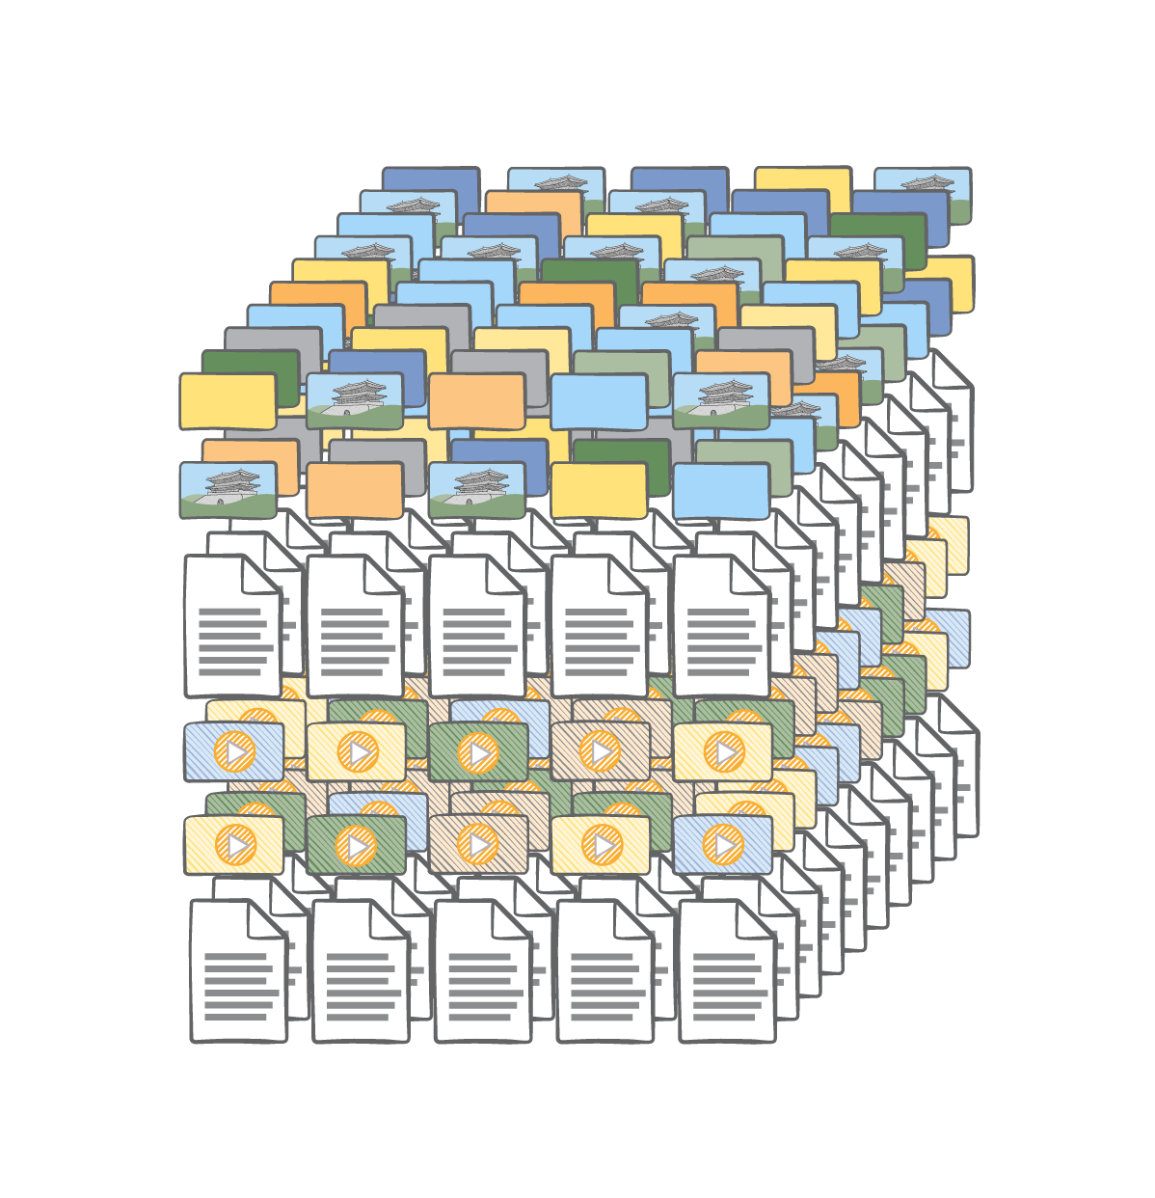
Automatic scaling
Customers can’t over or under provision
Customers pay only for what they use
E.g. Each object uploaded to Amazon S3 is an event
Each event becomes a Lambda request (hands free delivery)
Lambda scales to match the event rate

Slide 89

Bring your own code (BYOC)
Create threads and processes, run batch scripts or other executables, and read/write files in /tmp.
Include any library with a Lambda function code, even native libraries.

Slide 90
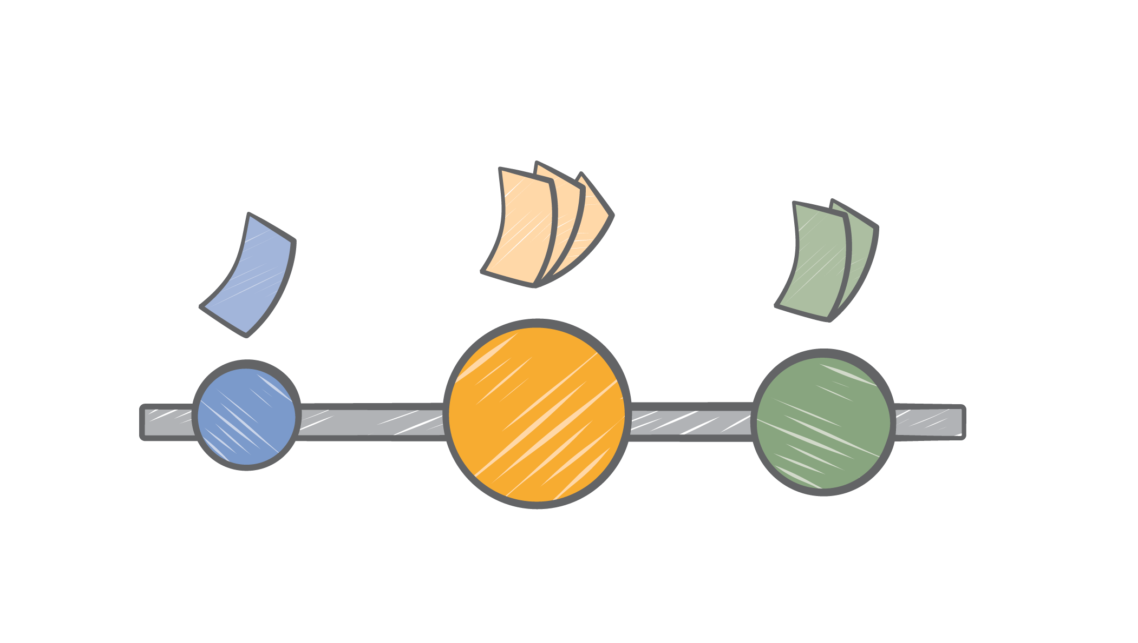
Fine-grained pricing
Price compute time by 100ms, so even short jobs make sense
Low request charge
No hourly, daily, or monthly minimums
Free tier

Slide 91
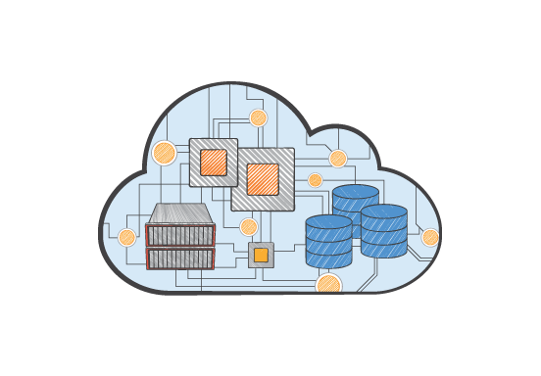

Event driven, modular services
Intelligent Infrastructure - Turn storage services like S3 and Dynamo into dynamic, reactive services.
Attach code to a stream so that it can automatically aggregate or transforms data flowing through.
Cost effectively add even small amounts of code, like audit checks, where you need them.

Slide 92
AWS Compute Offerings
Amazon EC2 - Flexibility
AWS Lambda - Simplicity
Customize your OS, environment, instance type
DIY fault tolerance
Assisted auto scaling by adding more instances
Any code, any language
Ease of use supplemented by ECS, Beanstalk
AWS-owned infrastructure
Built-in fault tolerance
Scale by sending more requests
Stateless code in supported languages (Node.js, Java, Python, & C# today)

Slide 93
What could we do with it?

Slide 94

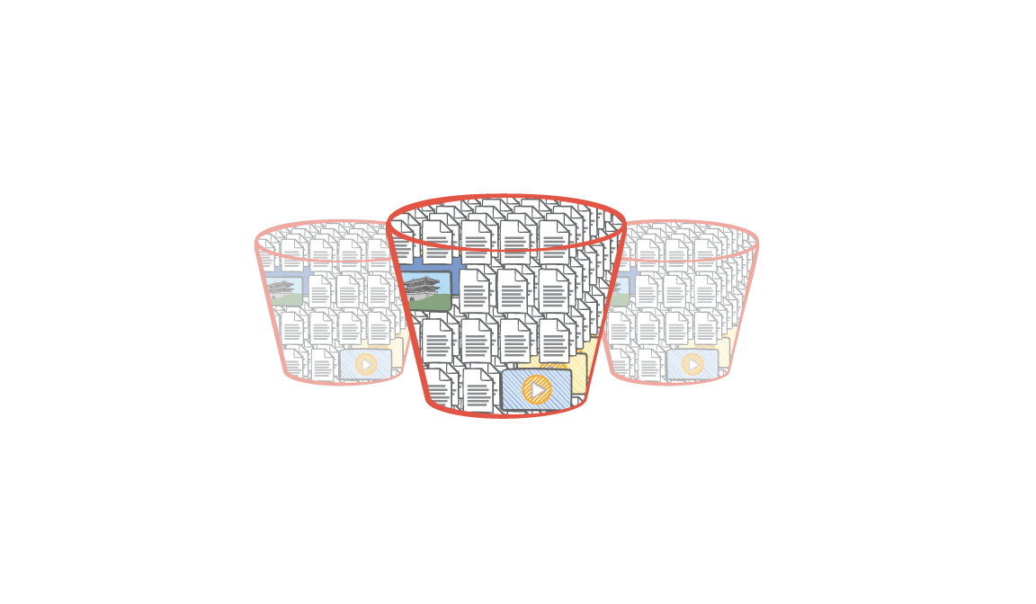
Data Triggers: Amazon S3
Original image
Thumbnailed image
1
3
λ
2
Amazon S3 Bucket Events
AWS Lambda
Notes:
Thumbnail images, compress files, synchronize object metadata with Amazon DynamoDB tables
Turn Amazon S3 into active storage
Easily audit AWS CloudTrail logs with AWS Lambda functions
Turn Amazon S3 into active storage

Slide 95
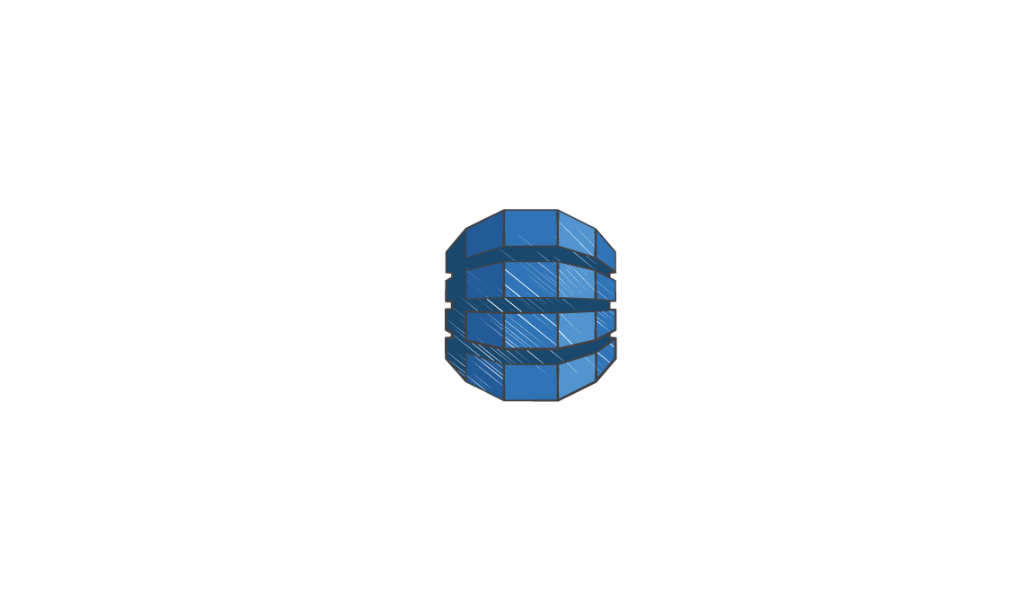
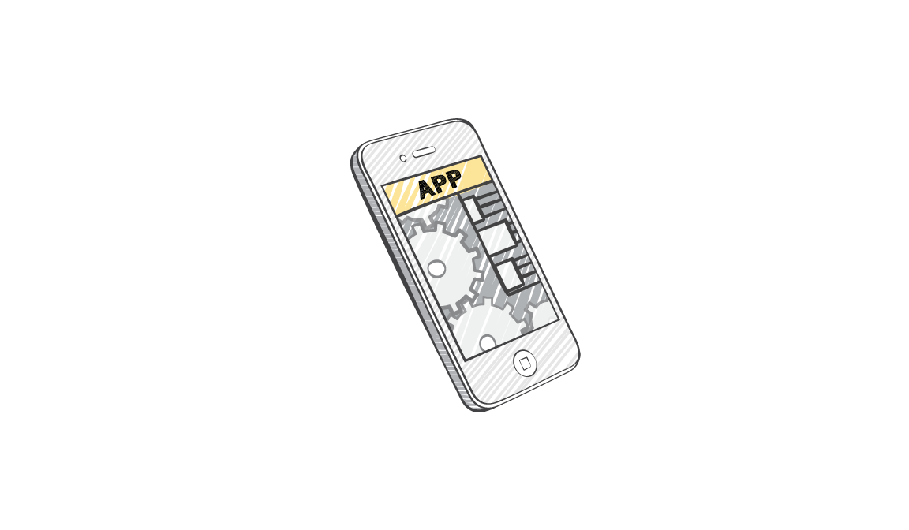

Data Triggers: DynamoDB
λ
Update another table
DynamoDB
Table and Stream
AWS Lambda
Send Amazon SNS notifications
Notes:
verify data formats, audit out-of-range values, filter and copy data to other tables

Slide 96

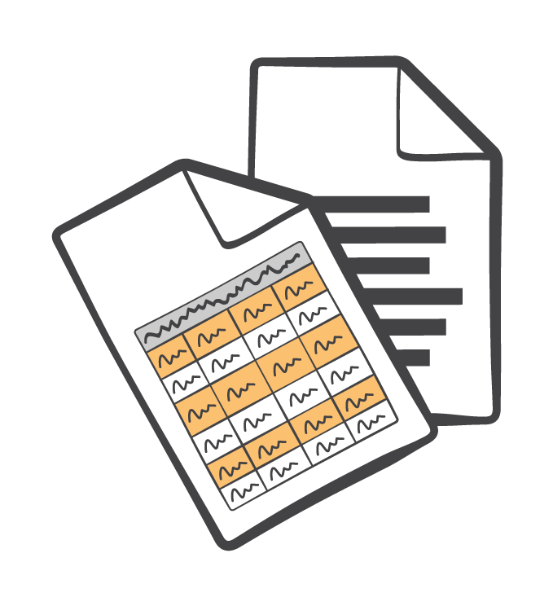


Audit and Notify
AWS CloudTrail Logs
λ
AWS API calls
Bucket events
Amazon SNS notifications
AWS Lambda
Notes:
Log AWS API usage with AWS CloudTrail
Use Amazon S3 bucket events and AWS Lambda to automate the log analysis
Detect suspicious activity or anomalies and notify via Amazon SNS, email, or logs
Same technique can be used for any S3 log data

Slide 97

Custom Events
λ
AWS Lambda
Notes:
Call AWS Lambda’s asyncInvoke API directly from your application, providing a custom event (json) to process

Slide 98
How do I use it?

Slide 99
Writing the Code
The Basics
Node.js, Java, Python, C# more languages to come
AWS SDK comes built in and ready to use
ImageMagick graphics library included
Stateless
Use Amazon S3, DynamoDB, or other Internet-available storage for any persistent data
Don’t expect affinity to the infrastructure (you can’t “log in to the box”)
Familiar
Use processes, threads, /tmp (500MB), sockets, Environment Variables
KMS, VPC options
Bring your own libraries, even native ones
No inbound socket connections

Slide 100
Configuring the Lambda Functions
Pick a name.
Pick a size.
Set memory to any size from 128MB to 1536MB, in 64MB steps
Receive an equivalent portion of other resources (disk, network, compute power, etc.)
Easy, single-dial solution to set price/performance preference.
Lambda tells you how much memory you used, so you can tune this setting.
Set a timeout
Up to 5 minutes
Pick an event source (or several).

Slide 101
Wiring up Events
AWS services send events to Lambda as JSON
Events are reliably transmitted
Lambda functions run for each event
PUSH: Amazon S3 and custom events
Unordered model
3 retries, Dead Letter Queue
PULL: DynamoDB and Amazon Kinesis
Ordered model with multiple records per event
Unlimited retries (until data expires)

Slide 102
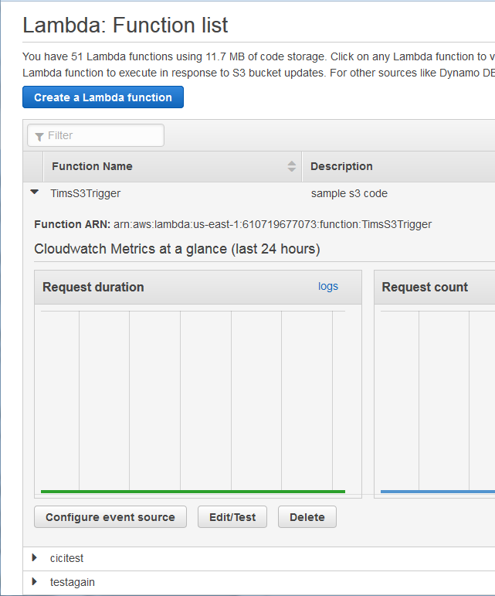
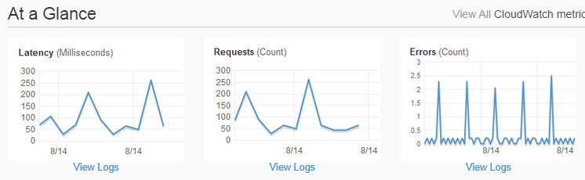
Monitoring Lambda Functions
Lambda console includes a dashboard for functions
Lists all Lambda functions
Easy editing of resource and other settings
At-a-glance metrics
Metrics automatically reported to Amazon CloudWatch for each Lambda function
Requests
Errors
Latency

Slide 103
Debugging Lambda Functions
Lambda automatically logs function execution in Amazon CloudWatch Logs on your behalf
Each Lambda function gets its own log group
Default log entries for execution start/end and resources consumed.
You can easily add custom log entries.
exports.handler =
function(event, context) {
console.log('Received event:');
var bucket =
event.Records[0].s3.bucket.name;
var key =
event.Records[0].s3.object.key;
console.log(‘Bucket: ‘+bucket);
console.log(‘Key: ‘+key);
…

Slide 104

Best Practices
Set up roles correctly
Execution roles determine what your function can do
Invocation roles determine who can execute it
Use recursion with care
If you write an object to Amazon S3 or DynamoDB inside an event handler, you will trigger another event!

Slide 105



Introducing Amazon API Gateway
Host multiple versions and stages of your APIs
Create and distribute API Keys to developers
Leverage AWS Sigv4 to authorize access to APIs
Throttle and monitor requests to protect your backend
Utilizes AWS Lambda
Notes:
Based on the feedback we received from our customers we worked on a new product, Amazon API Gateway.
The ability to create and run multiple version of an API simultaneously. We have also built Stages. These enable developers to deploy multiple stages of each version simultaneously. For example, dev stage, prod stage, or beta stage.
API Gateway helps developers create, monitor, and manage API Keys that they can distribute to 3rd party developers
Developers who already own an authentication and authorization system can leverage their own infrastructure. For developers who are starting from scratch we have introduced the ability to leverage AWS’ own authorization mechanisms such as Signature V4 on Requests and IAM access policies for fine-grained access control
At AWS we already run a very large, reliable network. API Gateway helps developers leverage all the work we have done over the years and allows developers to throttle incoming requests and use CloudWatch to monitor the status and latency of their APIs and set Alarms.
Finally, it turns out AWS already had the perfect tool for developers who wanted to build server-less backends, it’s AWS Lambda. With the API Gateway customers can now expose AWS Lambda functions as API endpoints.

Slide 106
Introducing Amazon API Gateway
Managed cache to store API responses
Reduced latency and DDoS protection through CloudFront
SDK Generation for iOS, Android, Java, and JavaScript
Swagger support
Request / Response data transformation (Apache Velocity) and API mocking
Notes:
And beyond this, we’ve listened and included additional features such as…
Customers will be able to provision and configure a dedicated cache for their APIs, we will serve responses from the cache without hitting a customer’s backend whenever possible
Continuing our story on leveraging the powerful network AWS has built, API Gateway leverages Amazon CloudFront to create global distributions for customer’s APIs, this lowers the latency for end users but also gives our customers’ APIs DDoS protection out of the box, both for malicious requests (Layer 7) and for lower level attacks (Layer 3, SYN floods)
API Gateway can automatically generate client SDKs based on our customer’s API definition. This allows developers to take their APIs from concept to integration test in a client app in a matter of hours, now weeks
Many of our customers use Swagger to define their APIs. API Gateway can import Swagger definitions. We have also built an open source Swagger import tool that our customers can use as part of their development workflow. This way they can keep working with Swagger in their local repository, then import and deploy their APIs into API Gateway at build time
We have also integrated with the Apache Velocity templating engine, this allows our customers to transform the shape of requests and responses as they flow through the API Gateway. This gives customers the ability to expose legacy endpoints as modern, RESTful APIs among many other things.

Slide 107
How Does Amazon API Gateway Work?

Slide 108
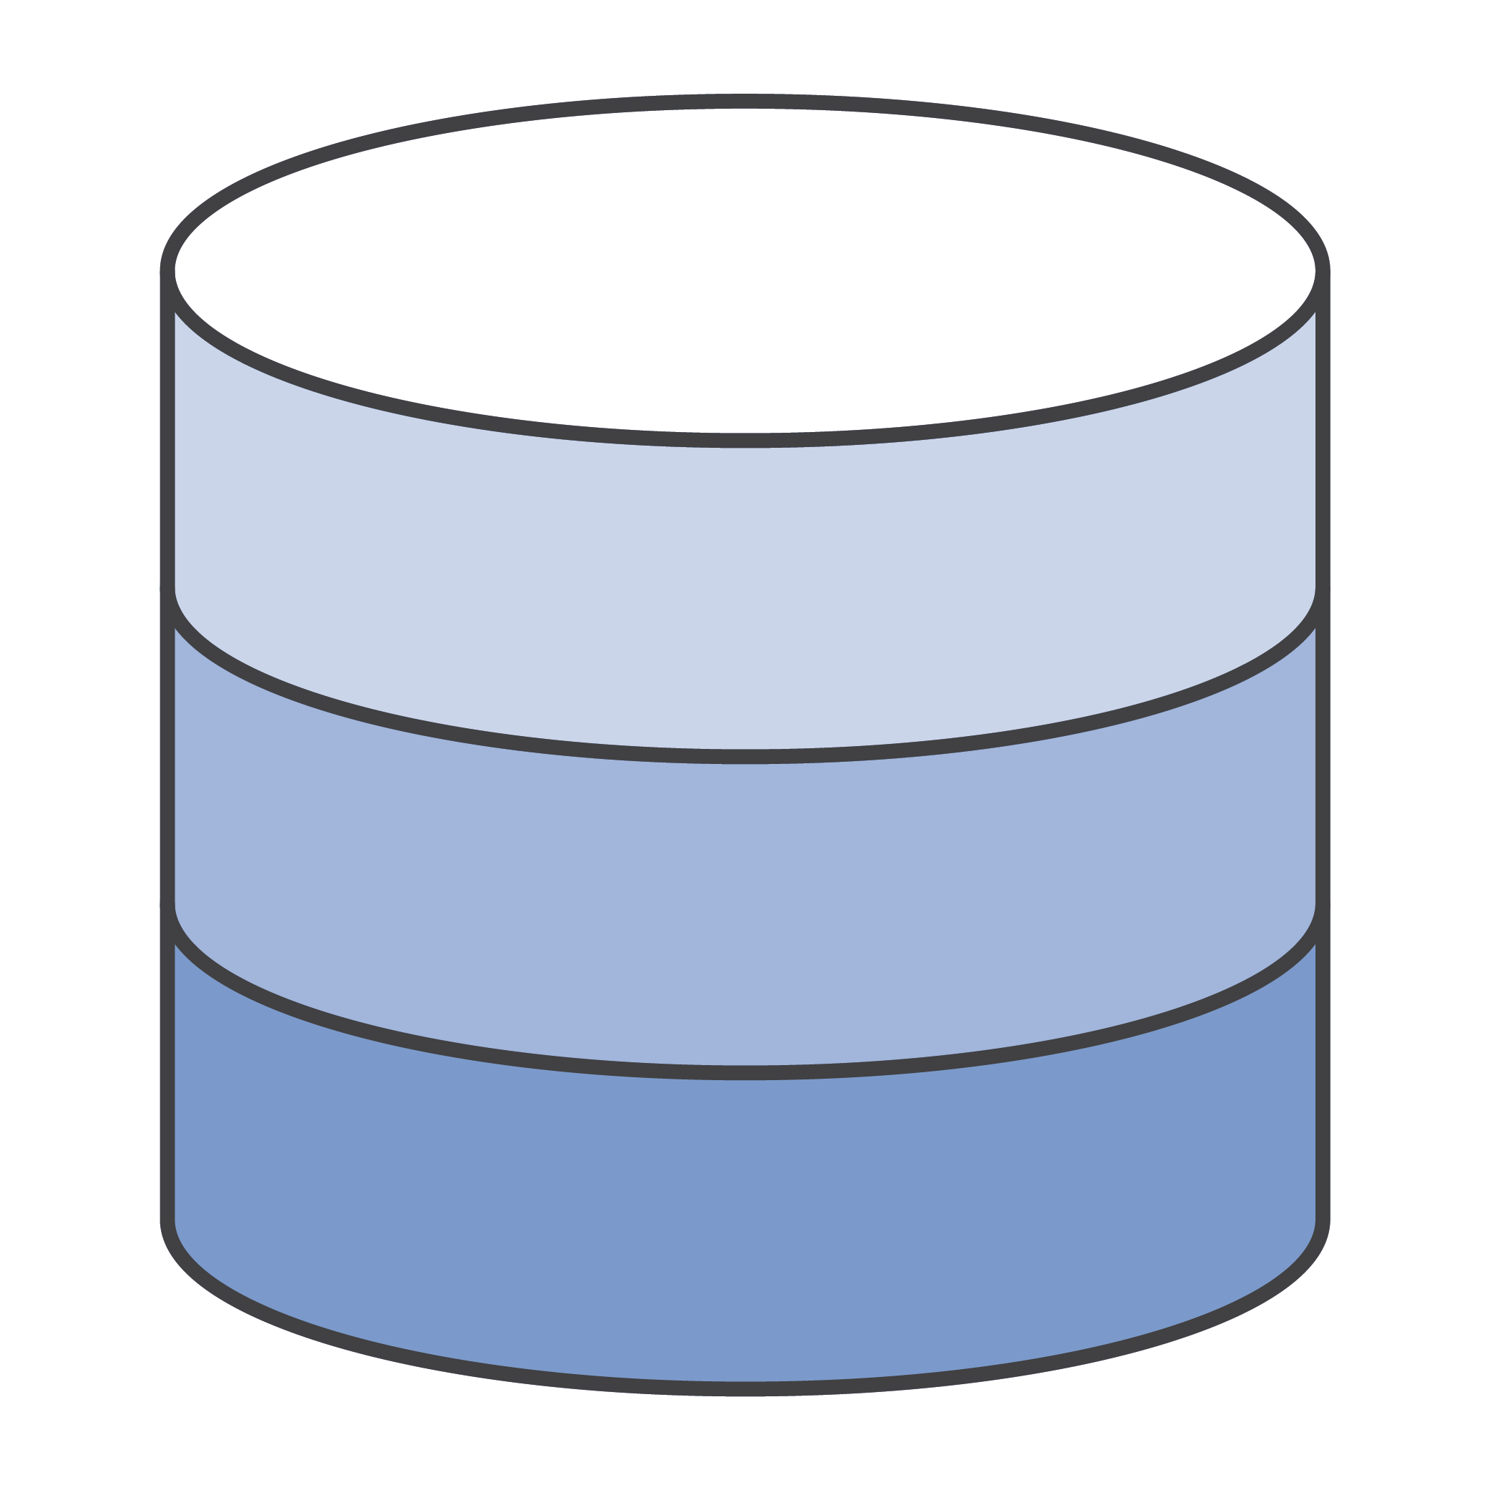






An API Call Flow
AWS
API Gateway Cache
AWS Lambda functions
Mobile Apps
API Gateway
Websites
Internet
Endpoints on Amazon EC2 / Amazon Elastic Beanstalk
Services
Amazon CloudWatch Monitoring
Any other publicly accessible endpoint
Notes:
The first thing we want to look at is the standard flow of an API call, including all components in the system
First, a request comes in from a client, this could be a mobile device, a web application or a backend service
The requests arrives at one of our CloudFront PoP locations, it’s accepted and routed through to the API Gateway in the customer’s region
The API Gateway receives the request, then checks for records in the dedicated cache (if it is configured). If there are no cached records available then it will forward the request to the backend for processing
The backend can be a Lambda function, a web service running on Amazon EC2, or any other publicly accessible web service
Once the backend has processed the request the API call metrics are logged in Amazon CloudWatch and the content is returned to the client

Slide 109
Build, Deploy, Clone & Rollback
Build APIs with their resources, methods, and settings
Deploy APIs to a Stage
Users can create as many Stages as they want, each with its own Throttling, Caching, Metering, and Logging configuration
Clone an existing API to create a new version
Users can continue working on multiple versions of their APIs
Rollback to one of the last 300 deployments
We keep a history of customers’ deployments so they can revert to a previous deployment
Notes:
Let’s look at what is an API, how you build, and how you deploy an API
The first step is to create a new API, and declare its resources and methods. Once an API is declared it can be tested from the Console or the API Gateway APIs, but it is not yet accessible on the internet
To make the API available it needs to be deployed to a Stage. Stages help you manage your development, beta, production environments etc. Customers can create as many stages as they want, similar to tagging. Each stage can be configured with its own logging, throttling, monitoring and caching settings
At any time you can clone the state of an existing API into a new one, this allows you to start working on v2 of your APIs while v1 is still being developed/fixed.
API Gateway saves a history of the last 300 deployments to each stage, at any time you can point a Stage (for example production) to a different deployment

Slide 110
API Configuration
Pet Store
/pets
/pets/{petId}
GET
PUT
POST
You can create APIs
Define resources within an API
Define methods for a resource
Methods are Resource + HTTP verb (7)
Notes:
Let’s look in details at the hierarchical structure of an API
The top level element is the API itself, we call it a REST API.
A rest API can contain many resources, resources are typed objects that are part of your API’s domain. They also represent the path through which the objects will be accessible
You can nest resources, in our example the /pet/{petId} represents an individual pet and is a nested resource of the /pets/ resource.
Each resource can declare methods. Methods are the combination of a resource + an HTTP Verb. We support 7 standard HTTP Verbs, For example, a method is the POST to the /pets/{petId} resources – this would be used to create a new pet

Slide 111
API Deployments
Pet Store
dev
beta
gamma
prod
API Configuration can be deployed to a stage
Stages are different environments
For example:
Dev (e.g. awsapigateway.com/dev)
Beta (e.g. awsapigateway.com/beta)
Prod (e.g. awsapigateway.com/prod)
As many stages as you need
Notes:
Now that we have declared an API with its resources and methods, we can deploy it to make it accessible to 3rd party developers
APIs are deployed to a Stage
Stages represent environments, for example development of production
In API Gateway Stages are like tags, and developers can create as many stages as they want. A stage is just an alphanumeric string
Stages are part of the path that will be used to reach sources and methods, for example the prod stage will be available at execute-api.apigateway.com/stage/resource

Slide 112
Custom Domain Names
You can configure custom domain names
Provide API Gateway with a signed HTTPS certificate
Custom domain names can point to an API or a Stage
Pointing to an API you have access to all Stages
Beta (e.g. yourapi.com/beta)
Prod (e.g. yourapi.com/prod)
Pointing directly to your “prod” Stage
Prod (e.g. yourapi.com/)
Notes:
Customers can configure the API Gateway to use a custom domain name they provide instead of the standard AWS domain.
We expect customers to bring their own signed certificate for the HTTPS endpoints
Domain names can be configured to point to an API, our top level item, or directly to a specific stage within an API.
Pointing a custom domain name to an API requires the stage to be included in the path
If the domain name is pointed directly at a stage there is no need for the path variable, resources can be accessed directly form the API root “/”

Slide 113
API Keys to Meter Developer Usage
Create API Keys
Set access permissions at the API/Stage level
Meter usage of the API Keys through CloudWatch Logs
Notes:
API Keys are a great tool to manage the community of 3rd party developers interacting with the APIs
API Gateway allows customers to create API Keys through a console interface or through an API for programmatic creation.
Customers can set permissions on API Keys and allow access only to a set of APIs, or stages within an API
Calls made by an API Key are logged in CloudWatch so that customers can always track utilization by 3rd party developers

Slide 114



API Keys to Authorize Access
The name “Key” implies security – there is no security in baking text in an App’s code
API Keys should be used purely to meter app/developer usage
API Keys should be used alongside a stronger authorization mechanism
Notes:
We always get asked whether API Keys are the authorization mechanism for APIs, so we’ll just be upfront: NO, at least we don’t recommend it
We strongly encourage customers to use a temporary tokens based on a successful user authentication, either by leveraging AWS temporary credentials through API Signature Version 4, or their own Oauth mechanism

Slide 115
Leverage AWS Sigv4, or Use a Custom Header
You can leverage AWS Sigv4 to sign and authorize API calls
Amazon Cognito and AWS Security Token Service (STS) simplify the generation of temporary credentials for your app
You can support OAuth or other authorization mechanisms through custom headers
Simply configure your API methods to forward the custom headers to you backend
Notes:
AWS gives customers the ability to retrieve temporary, limited privilege credentials that are tied to an IAM role within their AWS account through services like Cognito and STS.
Based on these credentials developers can sign calls to the APIs, the generated client SDKs automatically know how to handle these credentials
In the next slide we’ll go through a real-world use-case for this
Alternatively customers can setup the API Gateway to forward their existing headers to keep using their current OAuth authorization schema

Slide 116


Using Sigv4 to authenticate calls to your API
Client
API Gateway
Backend
Call Login API, no auth required
/login
Lambda fn_login
User Accounts database
Credentials verified
Cognito developer authenticated identities
Receives credentials to sign API calls
Access and secret key
/login
Notes:
We’ll go through a use case that leverage AWS Lambda and Amazon Cognito to retrieve temporary credentials for a particular end user and authorize access to the APIs
As discussed before the API Gateway helps customers leverage AWS Sigv4 – only one open API is required and then we can verify signatures on all other calls.

Slide 117
API Throttling
Throttling helps you manage traffic to your backend
Throttle by developer-defined Requests/Sec limits
Requests over the limit are throttled
HTTP 429 response
The generated SDKs retry throttled requests
Notes:
API Gateway uses throttling to help protect customer backends and send only request that they can handle
To implement throttling we use the token bucket algorithm
Customers can set the number of RPS calls they know their backend can handle, and a rate at which the bucket is refilled

Slide 118
Caching of API Responses
You can configure a cache key and the Time to Live (TTL) of the API response
Cached items are returned without calling the backend
A cache is dedicated to you, by stage
You can provision between 0.5GB to 237GB of cache
Notes:
To limit the number of requests their backend can receive, and further bring down latency customers can configure a dedicated cache for each stage of their API
For each method in their APIs customers can configure which parameters between path, query string and headers form the item key in the cache, and assign each item a time to live
API Gateway automatically caches responses where configured and avoids calling the customer’s backend if the cached item is available and valid
Customers have access to APIs to manage their cache in the API Gateway
When a stage is configured with a dedicated cache, and an item is found to be in cache and valid for a request that would otherwise be throttled, the API Gateway will handle the request and return the cached response
Customers can pick for a range of possible cache sizes to provision a dedicated cache from their stage, from 0.5GB all the way up to 237GB

Slide 119
Request processing workflow
Receive incoming request
Check throttling configuration
Execute backend call
Check for item in dedicated cache
If found return cached item
Check current RPS rate
If above allowed rate return 429
Notes:
Let’s put the two together and look at the execution path of an API call
First, when we receive a request, we will check the dedicated cache (if it’s been configured)
If we have an item in the cache then we can handle the request regardless of the throttling configuration, it will have no effect on our customer’s backend
Next, if we don’t have a cache, we check the throttling configuration and the current throttling state (our bucket)
If we are above the limit we will return a 429 response
Otherwise we will execute the backend call and return the result
As we mentioned our generated SDKs automatically know how to handle throttling responses, and they will perform an exponential backoff while retrying the call

Slide 120
API Models
Models are a JSON Schema representation of your API requests and responses
Models are used for input and output filtering, and SDK generation
You can reuse models across multiple methods in your API
Notes:
API Gateway handles resources as typed objects. Resources can have models associated with them.
Models are simply the JSON schema representation of the request and response data models
If the API Gateway is aware of the request and response models it can
Generate SDKs that include actual objects for each request and response rather than generic (JSON Object)
Allow JSON traversal of requests and responses in the data transformation engine

Slide 121
Input / Output Transforms
Use Velocity Templates to transform data
Filter output results
Remove private or unnecessary data
Filter dataset size to improve API performance
GET to POST
Read all query string parameters from your GET request, and create a body to make a POST to your backend
JSON to XML
Receive JSON input and transform it to XML for your backend
Receive JSON from a Lambda function and transform it to XML
Notes:
Let’s look at how request and response data can be transformed in-flight.
We use Apache Velocity as the standard to create, save and execute templates
We have been working with our customers on this and during development we have seen the following use-cases from them
Filter API responses. In many cases legacy APIs tended to return verbose responses with too many objects. Large payloads are a struggle for mobile applications, so customers are using the templates to traverse the response schema and filter the output to return only the necessary fields
RPC to REST. Customers have RPC-style APIs that they wanted to expose to the world in the form of RESTful APIs. RPC often only accept POST calls. Customers used the transform templates to accept a GET call in the API Gateway, then generate the POST body for their backend call reading parameters from the path, query string and headers
Customers who want to leverage Lambda but only run XML APIs have been using the transform templates to receive the JSON output from Lambda, and turn it into an XML before sending it back to the end user. This has allowed them to completely switch their backend technology while causing no disruption for 3rd party developers utilizing their APIs, very neat tablecloth trick. Example: Twilio

Slide 122
Generate Client SDKs Based on Your APIs
SDKs are generated based on API deployments (Stages)
If Request and Response Models are defined, the SDK includes input and output marshalling of your methods
SDKs know how to handle throttling responses
SDKs also know how to sign requests with AWS temporary credentials (SigV4)
Support for Android, iOS, JavaScript, …
Notes:
API Gateway can generate client SDKs based on a customer’s API definition.
Simply select the deployment the SDK should target, the platform, and setup a couple of parameters and the API Gateway generates an SDK and makes it available to download through an API or the management console
SDK are model-aware and also come with the built-in AWS core that allows them to handle throttling responses and sign requests using AWS Credentials

Slide 123
6
Building a Mobile App

Slide 124











Authenticate users
Store and share media
Amazon Cognito
(Identity Broker)
Amazon S3
Transfer Manager
Integrated access
Your Mobile App
Deliver media
AWS Identity and
Access Management
Amazon CloudFront
(Device Detection)
Synchronize data
Send push notifications
Amazon Cognito
(Sync)
Amazon SNS
Mobile Push
Collect user behavior
Store data in the cloud
Amazon Mobile
Analytics
Amazon DynamoDB
(Object Mapper)
Call server side logic
AWS Mobile SDK
Stream real-time data
Amazon Kinesis
(Recorder)
AWS Lambda
Notes:
How to build an app
1. Authentication
2. Authorization
3. Data Storage and Delivery (Upload and Download)
4. Data Analytics
5. Data Synchronization
6. Push Notifications
7. Shared Data
8. Stream real-time data
9.

Slide 125



AWS Mobile Stack
Your Mobile App, Game or Device App
Integrated SDK
AWS Mobile SDK, API Endpoints, Management Console
Mobile Optimized
Services
λ
λ
λ
λ
Lambda
Functions
Amazon Cognito
Amazon Mobile Analytics
Amazon SNS Mobile Push
Mobile Optimized
Connectors
AWS Lambda
Kinesis Recorder
DynamoDB Mapper
S3 Transfer Mgr
SQS Client
SES Client
Core Building Block
Services
Compute
Storage
Networking
Analytics
Databases
AWS Global Infrastructure (Regions, Availability Zones, Edge Locations)
Notes:
Such services are fully integrated with the rest of AWS offering, are optimized for mobile use cases, are accessible via a single Mobile SDK and share the same scalable, on-demand, global infrastructure of all our other AWS services.

Slide 126



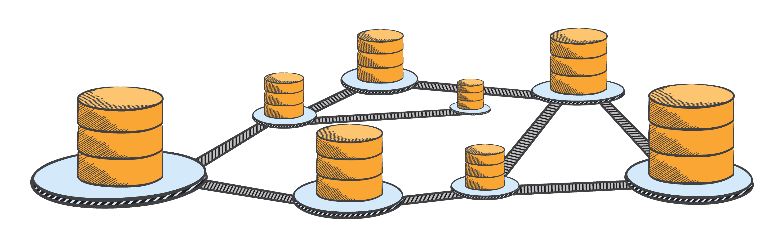








Amazon Cognito
“Your App data is secure, available offline, and kept in sync between devices”
Cross-device and Cross-platform Sync
Simplifies Identity and Access Management
Implement security best practices
Guest
Your own
Auth
Synchronize user’s data across devices and platforms
Manage users as unique identities across identity providers
Securely access all AWS services from Mobile device
Notes:
Amazon Cognito is a simple user identity and data synchronization service that makes it easy to securely manage your users data across their mobile devices. You can create unique identities for your users with information from a number of public login providers
You can save application data locally on the device and then securely sync and save this data to the cloud so your application can work online and offline. You can save any kind of data in Key/Value pairs such as application preferences or game state in the AWS Cloud without having to write any backend code or manage any infrastructure.
This means you can focus on creating great experiences instead of having to worry about building and managing a backend solution to handle identity, network state, storage, and sync.

Slide 127



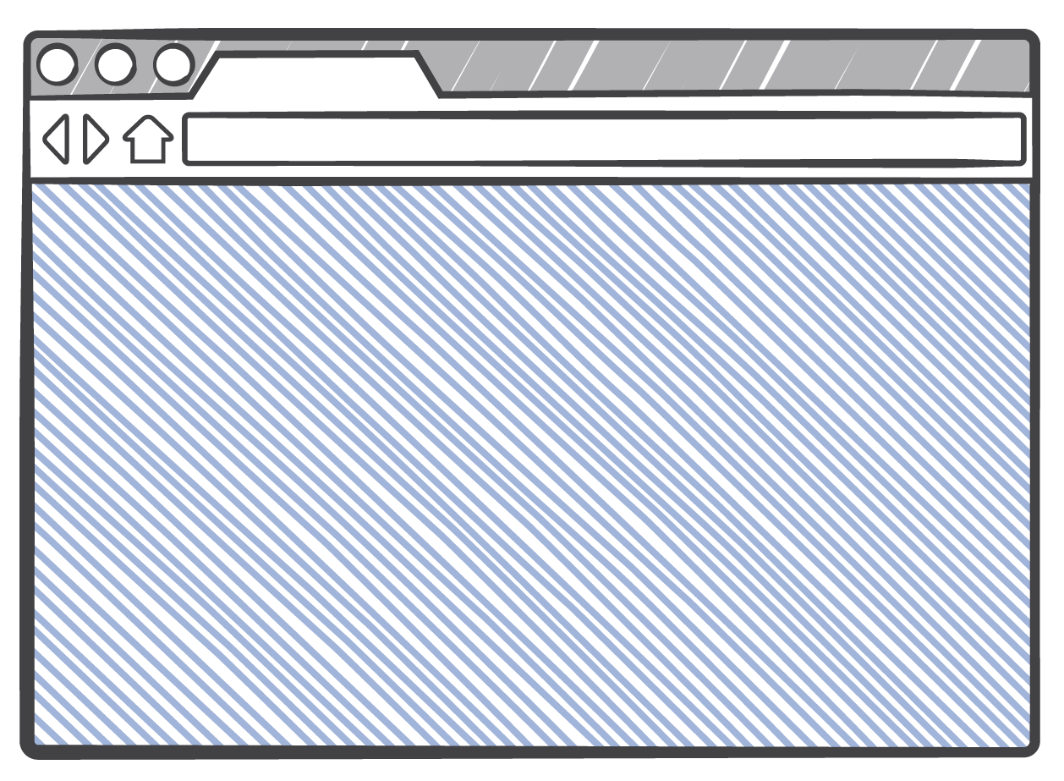


Amazon Cognito Identity
Unique
Identities
Joe
Anna
Bob
Support Multiple Login Providers
Easily integrate with major login providers for authentication.
Identity Providers
Unique Users vs. Devices
Manage unique identities. Automatically recognize unique user across devices and platforms.
Any Device
Any Platform
Helps implement security best practices
Securely access any AWS Service from mobile device. It simplifies the interaction with AWS Identity and Access Management
Any AWS
Service
Mobile Analytics
S3
DynamoDB
Kinesis
Notes:
One of the key benefits of Amazon Cognito is its Identity broker component. It creates a unique identifer and matches it when user’s login with any of the login providers. Developers have the flexibility to choose any login provider, in v1, we support G+, Amazon and Facebook and you can easily integrate using the SDK.
We focus on users and not login providers and manage the user preferences for that users.
Implementing AWS security best practices for accessing cloud resources with Amazon Cognito is easy. Amazon Cognito gives each app a set of temporary, limited privilege AWS credentials for each app user to access all AWS services.

Slide 128


Amazon Cognito for Unauthenticated Identities
Guest User Access
Securely access AWS resources and leverage app features without the need to create an account or logging in
Guest
Visitor
Preferences
Save Data to the Cloud
Save app and device data to the cloud and merge them after login
Unique Identifier for Your “Things”
“Headless” connected devices can also securely access cloud services.
EC2
S3
DynamoDB
Kinesis
Cognito Store
Notes:
We have seen that 90% users simply consumers of data and only 10% are actually content creators. Unauthenticated guest users are users just like logged in users. We should focus more on them, build services for them, and treat them like users, not second class citizens.
Amazon Cognito simplifies the way your application can access AWS resources in a secure manner, following AWS security best practices, even when your application users are not authenticated. Amazon Cognito creates a random, unique identifier for each unauthenticated guest so you can start saving application data for those users and also leverage the temporary, limited privilege credentials Amazon Cognito provides to access other AWS resources, such as Amazon S3 and Amazon DynamoDB. When your users decide to authenticate using one of the supported public login providers, Amazon Cognito ensures the data you saved against the unauthenticated profile is now associated with the new authenticated profile removing the complexity of managing user conversion.
By registering an unauthenticated user or by sending a login provider token to Amazon Cognito, your application receives a set of temporary, limited privilege credentials from Amazon Cognito to access your AWS resources. Amazon Cognito takes care of all the steps necessary to create a unique identifier for your app’s users and retrieve the AWS credentials. Incorporating AWS security best practices now takes just a few lines of code.

Slide 129
Amazon Cognito Security
Safeguard AWS Credentials
No need to embed credentials in the app anymore. Get least-privileged temporary credentials.
Helps implement security best practices
Securely access any AWS Service. It simplifies the interaction with Security Token Service and removes the need of Token Vending Machine
Set granular access permissions on AWS resources
Get fine-grained access control to cloud resources.
EC2
S3
DynamoDB
Kinesis
Notes:
And Lets first touch on the security aspect. We have seen a lot of developers tend to embed their AWS credentials in their app. These credentials are compromised if the app is decompiled.
Amazon Cognito, eliminates the need to embed you AWS credentials in the app.
Your mobile app authenticates with the identity provider (IdP) using the provider’s SDK. Once the end user is authenticated with the identity provider, the OAuth or OpenID Connect token returned from the identity provider is passed by your app to Amazon Cognito, which returns a new Cognito ID for the user and a set of temporary, limited-privilege AWS credentials. Amazon Cognito supports the creation and token vending process for unauthenticated users as well as authenticated users. Amazon Cognito creates a random, unique identifier for each unauthenticated user.
You can use the unique identifier generated for your app users in your Identity and Access Management policies. For example you can create a policy for an S3 bucket that only allows a particular user access to their own folder thus setting granular access permissions on AWS resources.

Slide 130

Developer-Authenticated Identities
Your own user authentication system
Several apps prefer to have their own username and password instead of public identity providers for authentication.
Your own Username
And Password
Easily integrate with existing systems
Implement GetOpenIdTokeForDeveloperIdentity() using our server-side SDKs like Java, Python, Ruby etc.
Manage mappings easily
Cognito manages the mappings across login systems (public or private) using a unique Cognito ID

Slide 131

Synchronize data across devices : Amazon Cognito (Sync)

Slide 132
Cognito Cloud Save and Sync
Store App Data, Preferences and State
Save app and device data to the cloud and merge them after login
User Data Storage and
Sync
Cross-device Cross-OS Sync
Sync user data and preferences across devices with one line of code
Identity pool
k/v data
Work Offline
Data always stored in local SQLite DB first. Works seamlessly when intermittent or no connectivity
Any Platform
No Backend Simple client SDK eliminates need for server side code
iOS/Android/FireOS
Notes:
With Amazon Cognito developers can synchronize application data across an end user’s devices with a single line of code.
With Amazon Cognito, developers can securely store application data, such as preferences and game state in the AWS cloud. With synchronized application data, developers can give your users a consistent, unified experience on their app across all of their mobile devices.
Developers can use Amazon Cognito directly from their mobile app without building or maintaining any backend infrastructure. Amazon Cognito handles secure application data storage and sync, enabling them to focus on their application experiences, instead of the heavy lifting of creating and managing a user application data sync solution.
It manages the complexity of conflict resolution and intermittent network connectivity by managing offline cache ensuring your application can always deliver a great user experience. Each data set in the Amazon Cognito sync store can be synchronized on all devices associated with an identity simply by calling the synchronize () method.

Slide 133


Amazon Cognito Sync
Offline: The client SDK manages a local SQLite data store to allow the app to work even when connectivity is not available.
Fast: The methods to read and write data only interact with the local SQLite database.
Intelligent Sync: The sync method compares the local version of the data to the cloud sync store, pushes up deltas and pulls down new changes.
Flexible Conflict resolution: The sync method first reads the changes then writes its local changes to the cloud sync store By default Cognito assumes that the last write wins. Developers can override and implement their own conflict resolution programmatically
Local SQLite Cache
Notes:
One identitypool across advertizers
Cognito id becomes a cookie id

Slide 134
Integrating Cognito Sync functionality is dead simple
Initialize the CredentialsProvider and CognitoClient
provider = new CognitoCachingCredentialsProvider (context, AWS_ACCOUNT_ID, COGNITO_POOL_ID, COGNITO_ROLE_UNAUTH, COGNITO_ROLE_AUTH, Regions.US_EAST_1);
cognito = new CognitoSyncManager (context, Regions.US_EAST_1, provider);
Create or open Dataset and Add Key Values
cognito.openOrCreateDataset(datasetName);
dataset.put(key, value);
Call synchronize on the dataset
dataset.synchronize(new SyncCallback(){..});

Slide 135
Integrating Cognito Sync functionality is dead simple
iOS
Initialize the AWSCognitoSyncClient
AWSCognitoSyncClient *syncClient = [[AWSCognitoSyncClient alloc] initWithConfiguration: configuration];
Create or open Dataset and Add Key Values
DataSet *dataset = [syncClient openOrCreateDataSet:@"myDataSet"];
NSString *value = [dataset readStringForKey:@"myKey"]; [dataset putString:@"my value" forKey:@"myKey"];
Call synchronize on the dataset
[dataset synchronize];

Slide 136
Analyze User Behavior: Amazon Mobile Analytics

Slide 137


Amazon Mobile SDK - Analytics
App usage
App revenue
User retention
Custom in-app events
Reports
Business intelligence
Mobile Analytics
Notes:
Amazon Analytics is a service for collecting, visualizing and understanding app usage data at scale. The Amazon Analytics service is free , reports are updated within minutes from when data are received, and the data collected are owned by you. It is built to scale with your business and can collect and process billions of events per day from many millions of users.
It’s a crossplatform services, any device any OS (Android, IOS, FireOS) can send data to Analytics service and see granular reports

Slide 138
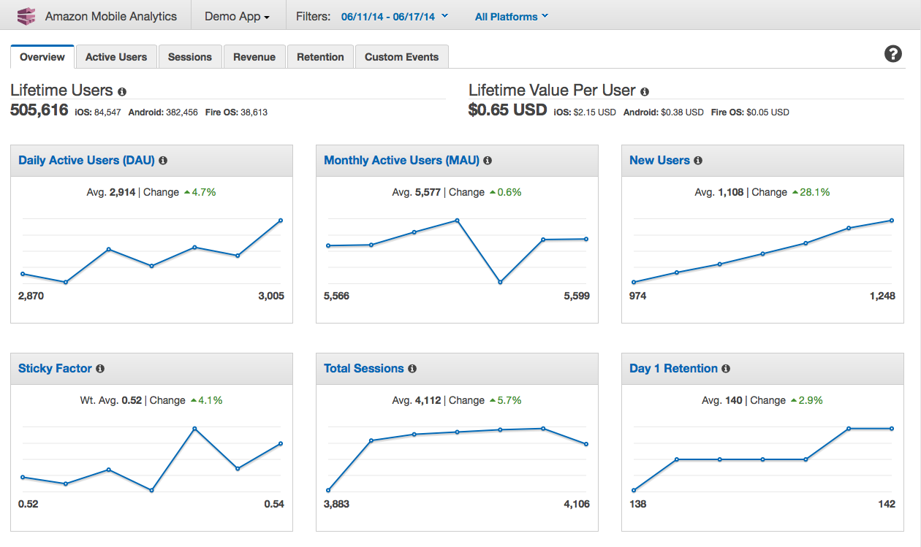
Key Business Metrics
(with one line of code)
Monthly Active Users (MAU)
Daily Active Users (DAU)
New Users,
Daily Sessions,
Sticky Factor,
1-Day Retention,
Avg. Revenue per DAU,
Daily Paying Users,
Avg. Paying DAU
Notes:
Quick Overview: Track nine pre-selected metrics in a simple to review dashboard to get a quick idea of engagement
Active Users: Track how many users engage with your app daily and monthly and monitor sticky factor to gauge engagement, appeal, and monetization
Sessions: Track how often your app is used on a given day and how often each user opens your app during a day
Retention: Measure the rate at which customers come back to your app on a daily and weekly basis, after first use
Revenue: Track in-app revenue trend data to identify areas for monetization improvement
Custom Events: Track custom defined user actions specific to your app
Sticky factor

Slide 139
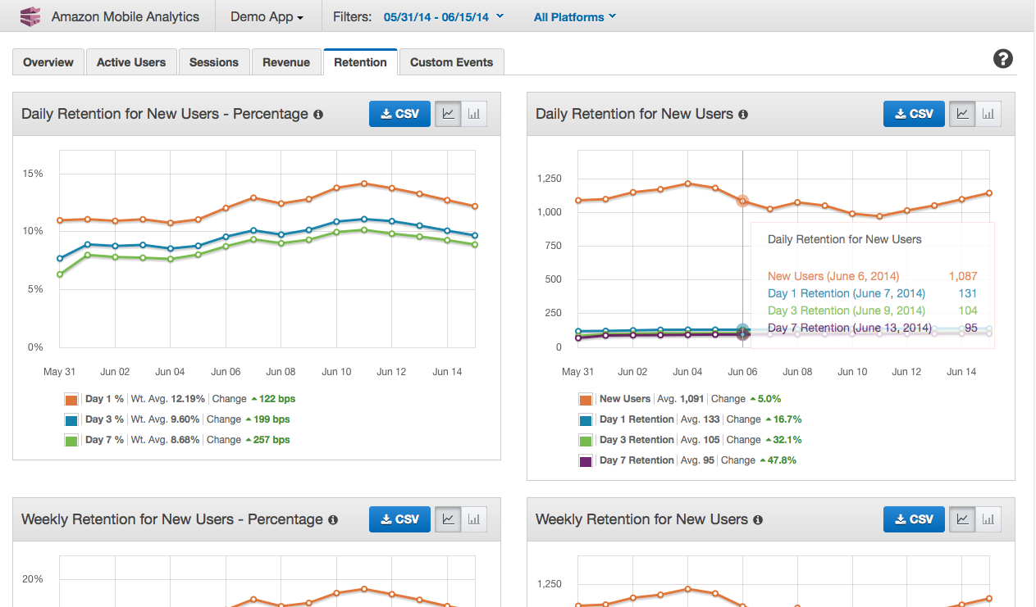
Track Retention
User retention is a key indicator to judge the outcome of a marketing campaign, new feature introduction, UX changes, app updates, etc.
Mobile Analytics provide four charts to track daily or weekly rate of returning users, after first use of the app
Notes:
User retention is a key indicator to judge the outcome of a marketing campaign, new feature introduction, UX changes, app updates, etc.
We have made it easy to track user retention with four charts, two for daily, and two for weekly retention estimates.
As an example, if you look at the upper right chart, the developer of this app can see that he had ~2,900 new user on June 6th, of which 700 came back on the 7th, 390 came back on the 9th and finally, 230 came back on the 13th.

Slide 140
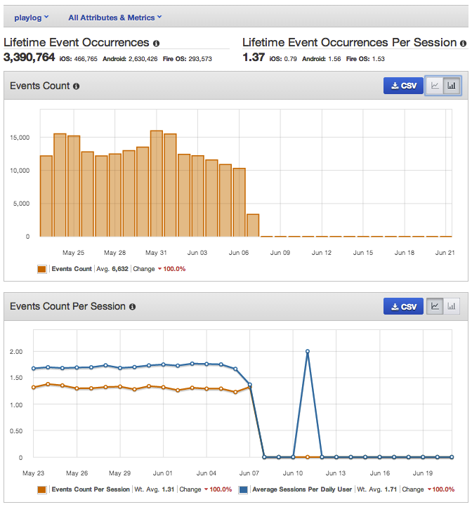
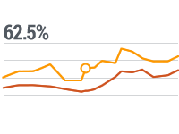
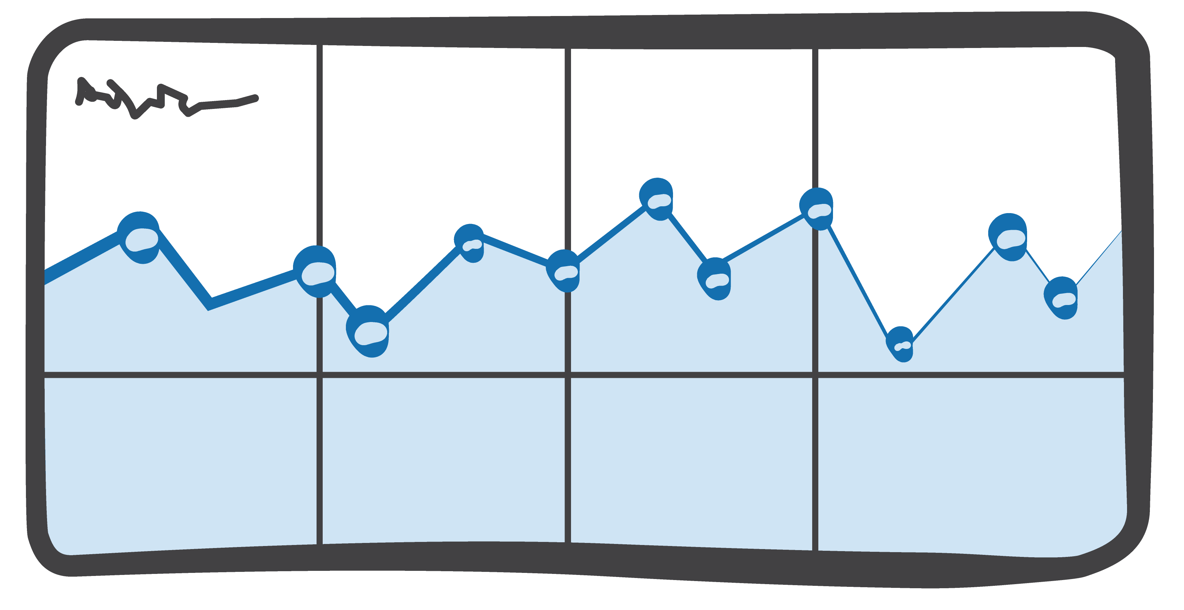


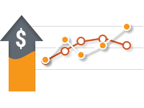

Track Custom Events
Get behavioral insights into app specific actions that your users take
Reports provide a view of how often custom events occur. You can add further context with Attributes and Metrics, to each custom event
Track the number of Likes/Shares, per article, in a news app
Number of songs played, per user session, in a music app
In-app item popularity in a shopping app
Understand player abort rates per level, in a game
Notes:
Custom Events let you track any action taken in your app, giving you an incredibly powerful insight into your user’s experience and behavior.
Custom Events are often used to track social events such as number of Likes/Shares, app specific events such as play progress/song played, and in-app purchase events such as transactions per product SKU.
Songs played is the custom even per session. Attribute numerical value associated with the data metric. Attribute: Weaponsused sword, how many people used the sword?

Slide 141
Integrating Mobile Analytics is super simple
Initialize the MobileAnalyticsManager. That’s it! Get Session Activity in the AWS Management Console.
private static MobileAnalyticsManager analytics;
analytics = MobileAnalyticsManager.getOrCreateInstance(
this.getApplicationContext(),"yourCompany.yourAppId", Regions.YOUR_REGION, config, cognitoProvider );
Add OnResume() and OnPause()
analytics.getSessionClient().resumeSession();
analytics.getSessionClient().pauseSession();
Analytics.getEventClient().submitEvents();
For Custom Events activity reports, add events.
EventClient eventClient = analytics.getEventClient();
MobileAnalyticsEvent visitEvent = eventClient.createEvent("speedSet");
eventClient.recordEvent(visitEvent);

Slide 142
Integrating Mobile Analytics is super simple
iOS
Initialize the AWSMobileAnalytics object. That’s it! Get Session Activity in the AWS Management Console.
AWSMobileAnalytics* analytics = [AWSMobileAnalytics
defaultAWSMobileAnalyticsWithIdentifier:@"someuniqueid"];
Create add Custom Events
id<AWSMobileAnalyticsEventClient> eventClient = analytics.eventClient;
id<AWSMobileAnalyticsEvent> level1Event = [eventClient createEventWithEventType:@"level1Complete"];
Submit the event. If we don't call submitEvents, events will automatically be submitted at periodic intervals.
[eventClient submitEvents];

Slide 143




Export to S3 & Process Data Anywhere
mobile client
Amazon Mobile Analytics
Amazon S3
Hadoop/Spark
Amazon EMR
Amazon Glacier
Amazon Redshift petabyte-scale warehouse

Slide 144




Amazon SNS - Mobile Notifications
Push notifications to Apple, Google, Fire OS, and Windows devices and to Android devices in China with Baidu Cloud Push. You can also send push notifications to MacOS desktops and Voice over IP (VoIP) apps on iOS devices. Send emails via SNS or send SMS messages to U.S. mobile numbers.
Send updates, promos, or news to individual users, a segment of users or all of your users with a single using Direct Messaging or SNS Topics.
Broadcast messages to many devices with a single Publish request.
Turn insights from Amazon Mobile Analytics into custom push notifications or use Amazon Cognito to associate device tokens with user identities.
Notes:
Today push notifications is the way to get to the app when the user is not using. It is extremely important functionality to drive engagement, retention and overal user experience. Customers tell us that working with diferent push notifications services is painful. They have to maintain serverside database of tokens issued by apple and android, and maintain the infastructure and different APIs. Moreover, sending push notifications to different parts of the world for example china, where there are more than 200 android appstores is extremely hard.

Slide 145


Each platform works differently, and push gets even more complex as you scale to support millions of devices.
Cloud App
Platform Services
Mobile Apps
Notes:
Each platform works differently, and push gets even more complex as you scale to support millions of devices.

Slide 146





Amazon SNS Mobile Push
New features:
Delivery Metrics via CloudWatch
Trigger Lambda Functions from SNS notifications
iOS
Apple iPhones and iPads
Apple APNS
Google GCM
Android Phones and Tablets
Baidu CP
Android Phones and Tablets in China
Internet
Amazon SNS
Cross-platform Mobile Push
Amazon ADM
Kindle Fire Devices
Windows WNS and MPNS
Windows Desktop and Windows Phone Devices
With Amazon SNS, developers can send push notifications on multiple platforms and reach mobile users around the world
Notes:
Amazon SNS Mobile Push is a managed, scalable, cross-platform push intermediary service. It abstracts the complexity of different push notification services and allows developers to send push notifications across different mobile endpoints. You can subscribe to topics and and send messages which are then relayed to apple, google, Windows, or Baidu notifications services

Slide 147
Mobile Application Testing : AWS Device Farm

Slide 148


Amazon Mobile Device Farm
Test on same devices your customers use
Integrate test automation into you CI workflow
Choose from existing tests or build your own
Analyze performance characteristics such as memory, CPU
Import Calabash tests for IOS and Android

Slide 149

Any Questions?

